Slide 1
Exploring New Approaches for Telomere Associations with Kidney Disease
Tiernan Coulter
CPH Summer Studentship
Under the Supervision of: Dr Claire Hill and Professor A.J McKnight
Notes:
Good afternoon everyone, my name is Tiernan Coulter. I’m a recent human biology graduate from Queen’s and I’m undertaking a summer studentship within the MEPH lab here at the CPH. I have been very fortunate to have been completing this studentship through being the first recipient of the “Janet Greeves’s Legacy Training Grant”, provided by the Northern Ireland Kidney Research Fund. I am currently 3 weeks into my project at the stage of recording this presentation, with another 5 exciting weeks yet to come. This presentation will discuss the various tasks I have completed, or will be completing throughout the studentship, the rationale for them, and what we hope to gain from completing them. Before we begin discussing the project, lets first set the scene with some background information on Telomeres and Kidney Disease.

Slide 2
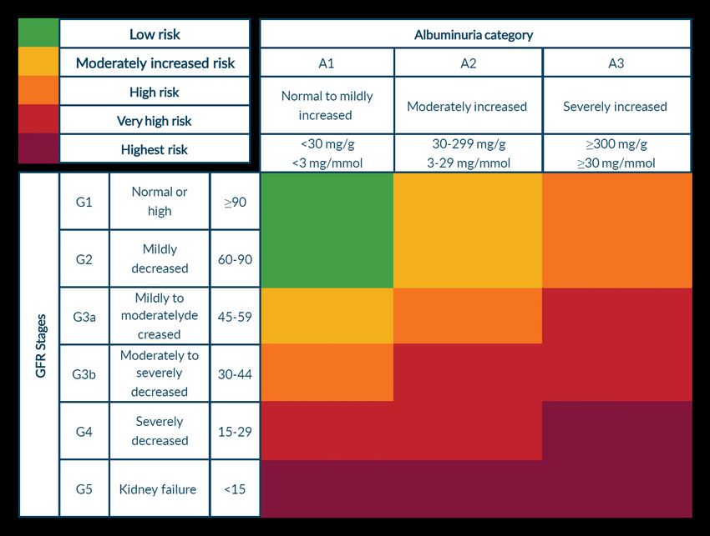
Chronic Kidney Disease
“An abnormality of kidney structure or function present for longer than 3 months and affecting a patient’s health” [1]
[2]
Notes:
CKD itself is defined as “an abnormality of kidney structure or function, present for longer than 3 months, affecting a patient’s health”. Kidney function is based upon estimated glomerular flow rate (eGFR) and albuminuria, with decreasing eGFR and increasing albuminuria associated with worsening CKD respectively. Changes in the severity of these factors allow for the categorisation of CKD into various stages, with increasing stages mirroring increasing severity. Once kidney function declines past a certain point, the kidney will reach end-stage kidney disease (ESKD). When CKD progresses to ESKD, it becomes a necessity for patients to receive kidney replacement therapy, either dialysis or kidney transplant. Both of these options heavily burden health services, patients and their families (runs onto next slide).

Slide 3
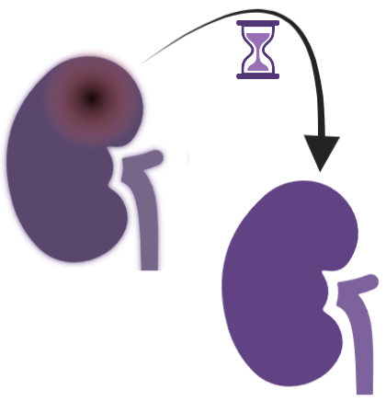
Chronic Kidney Disease
Increasing global prevalence – expected to be 5th leading cause of death by 2040 [3]
4 interventions to save 10,000 lives in 10 years [4]
Improved/Earlier Diagnosis
Increased Rate of Transplantation
Improved Disease Management
Better Use of Medications
Notes:
This burden caused by CKD is expected to increase as the prevalence of chronic kidney disease (CKD) is rising globally; with CKD projected to become the 5th leading cause of death by 2040. Indeed, in June 2023, Kidney Research UK declared kidney disease a UK public health emergency and highlighted four key interventions that could save more than 10,000 lives in the next ten years: these 4 interventions are an earlier / improved diagnosis, improved management of condition, greater use of medications and an increased rate of transplantation. With how great a public health crisis CKD is, it is truly imperative we improve our understanding of the factors that can cause or influence kidney disease

Slide 4
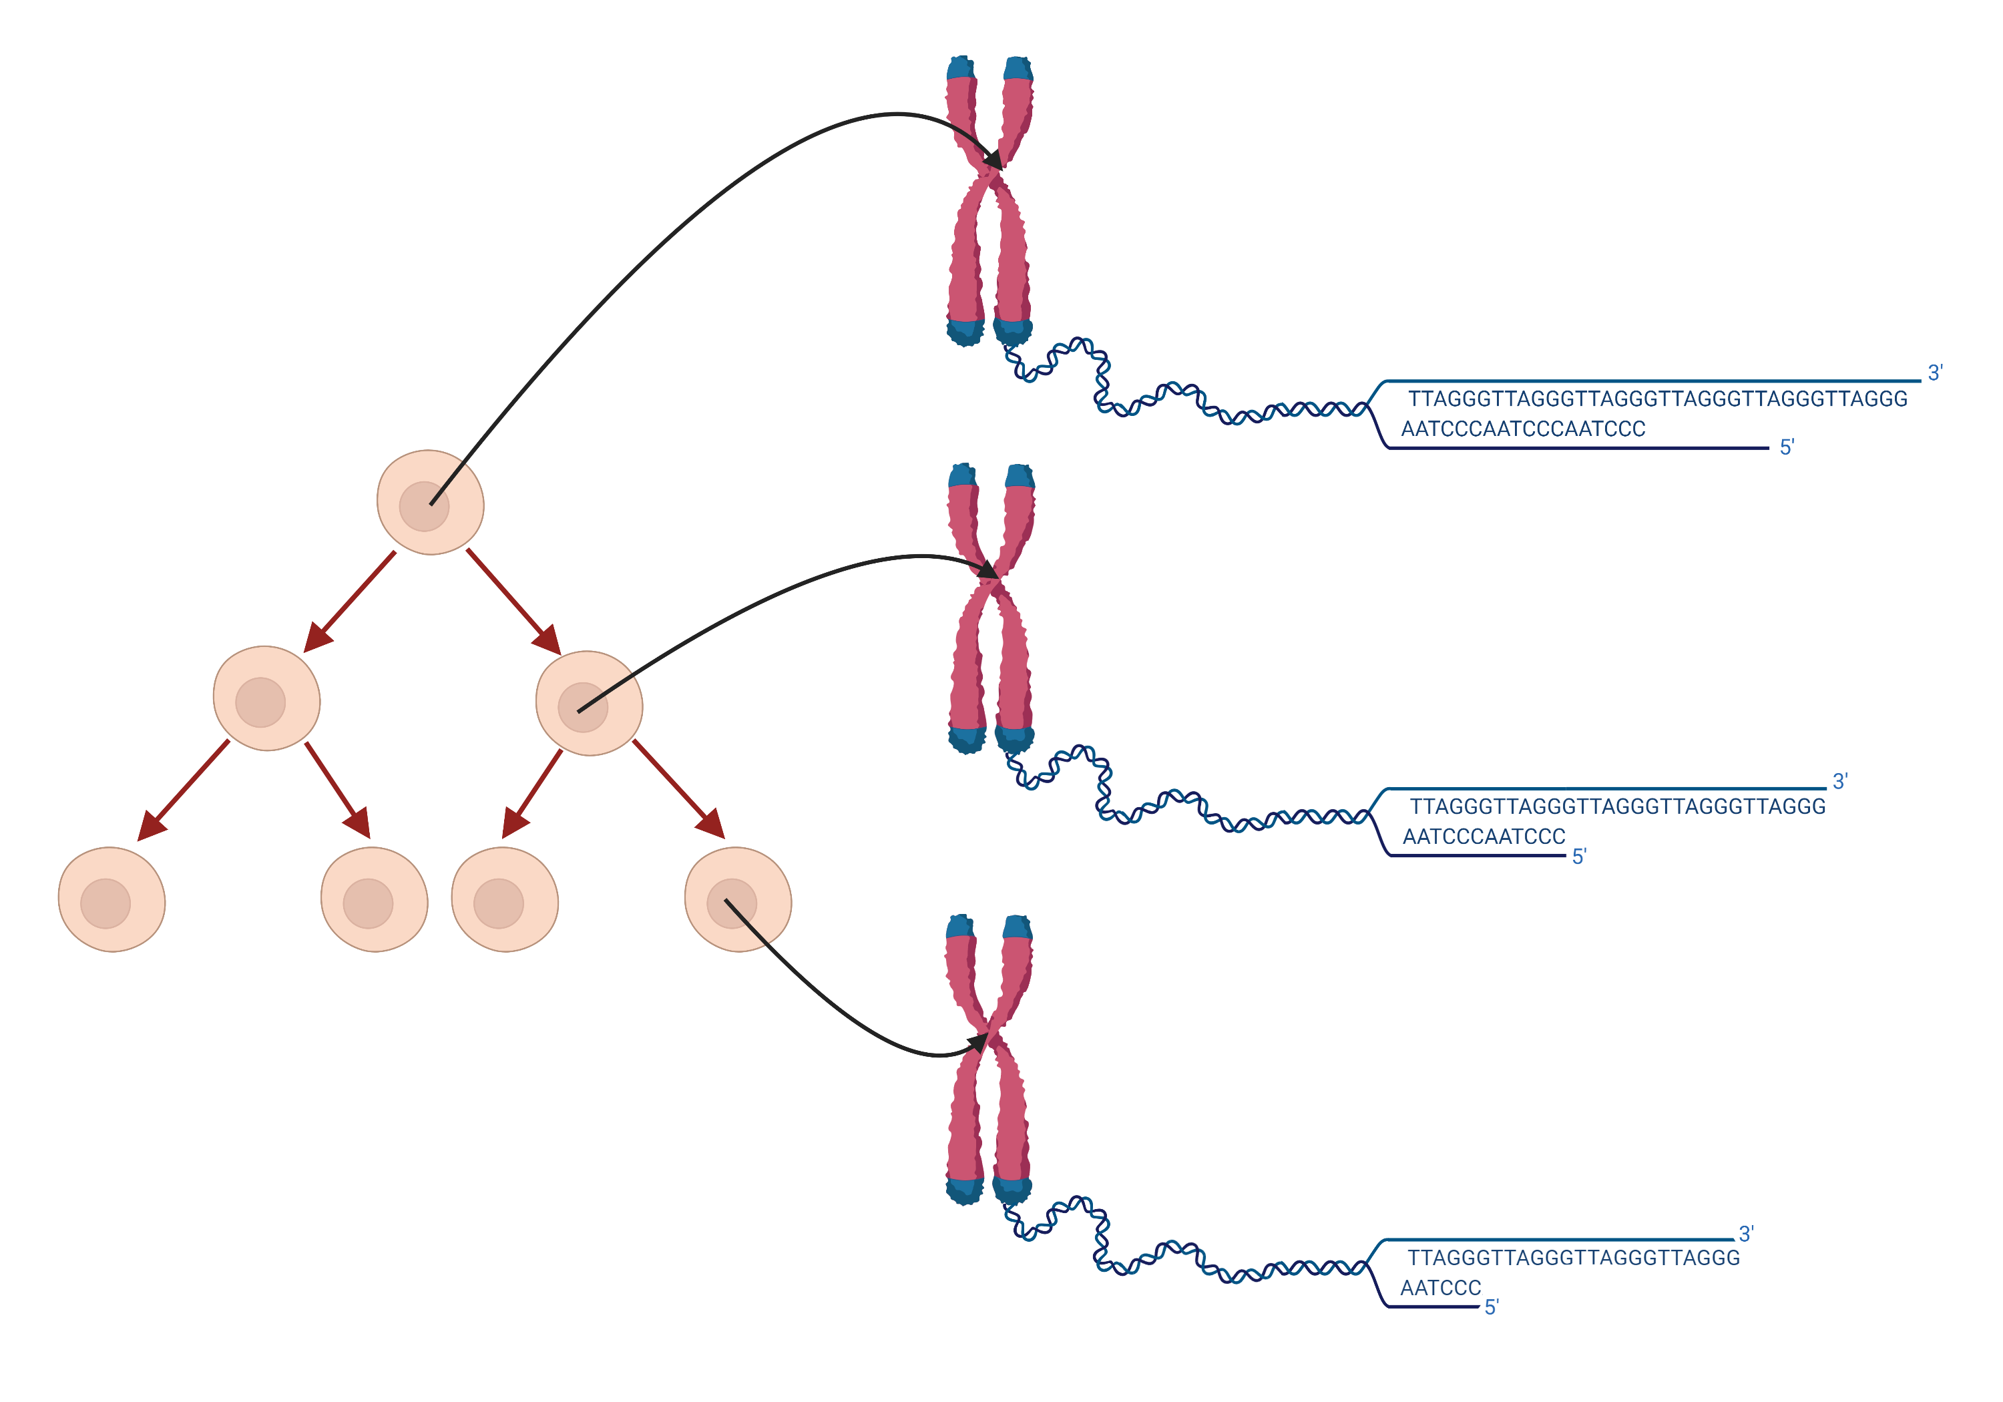
Telomeres
Repeating sequences of the same DNA
Protects important coding DNA
Variable Length:
Between individuals, and even cells in the same individual
Shortens every time a cell divides [5]
Length can be increased by “Telomerase”
Active in cells in that divide frequently, or stem cells [6]
Absent in most mature cells → continuous shortening
Genetic component of variation [7]:
Mutations in genes that control proteins that regulate telomeres
Environmental component of variation [7]:
Smoking, obesity, inflammation: Speeds up telomere shortening
Notes:
One such factor may be telomeres. Telomeres are repeating non-coding nucleotide sequences found at the end of eukaryotic chromosomes, acting as caps to protect the coding regions of DNA. The number of telomeric repeats vary from individual-to-individual, and even from cell-to-cell. There are many elements that play a role in determining the length of telomeres. The first, is the very nature of the molecular machinery utilised in cellular replication. With every cellular division, telomeres in the daughter cells are found to be shorter than they were in the parent cell. Conventional DNA polymerases are incapable of fully duplicating linear sequences, leading to the loss of a few telomeric repeats every division. However, telomere length alterations are not solely unidirectional. There is an enzyme called telomerase that acts to offset these repeating shortenings through the addition of new telomeric repeats in stem-like or highly mitotic cells. The issue with this, is that telomerase in not expressed within somatic cells, leading to continuous shortening of their telomeres until they reach a critical length. Before discussing the importance of this “critical length”, we will first turn our attentions to the other major factors affecting telomere length. There is a large genetic component to the regulation of telomeres, and thus their lengths. Genetic variation can arise as a consequence of polymorphisms, or mutations, within the genes that code for proteins involved in telomere regulation. There are also non-genetic variables that affect how telomere length is regulated. For example, smoking, obesity, and inflammation have all been found to associate with shorter telomeres, with many of these causing accelerated attrition.

Slide 5
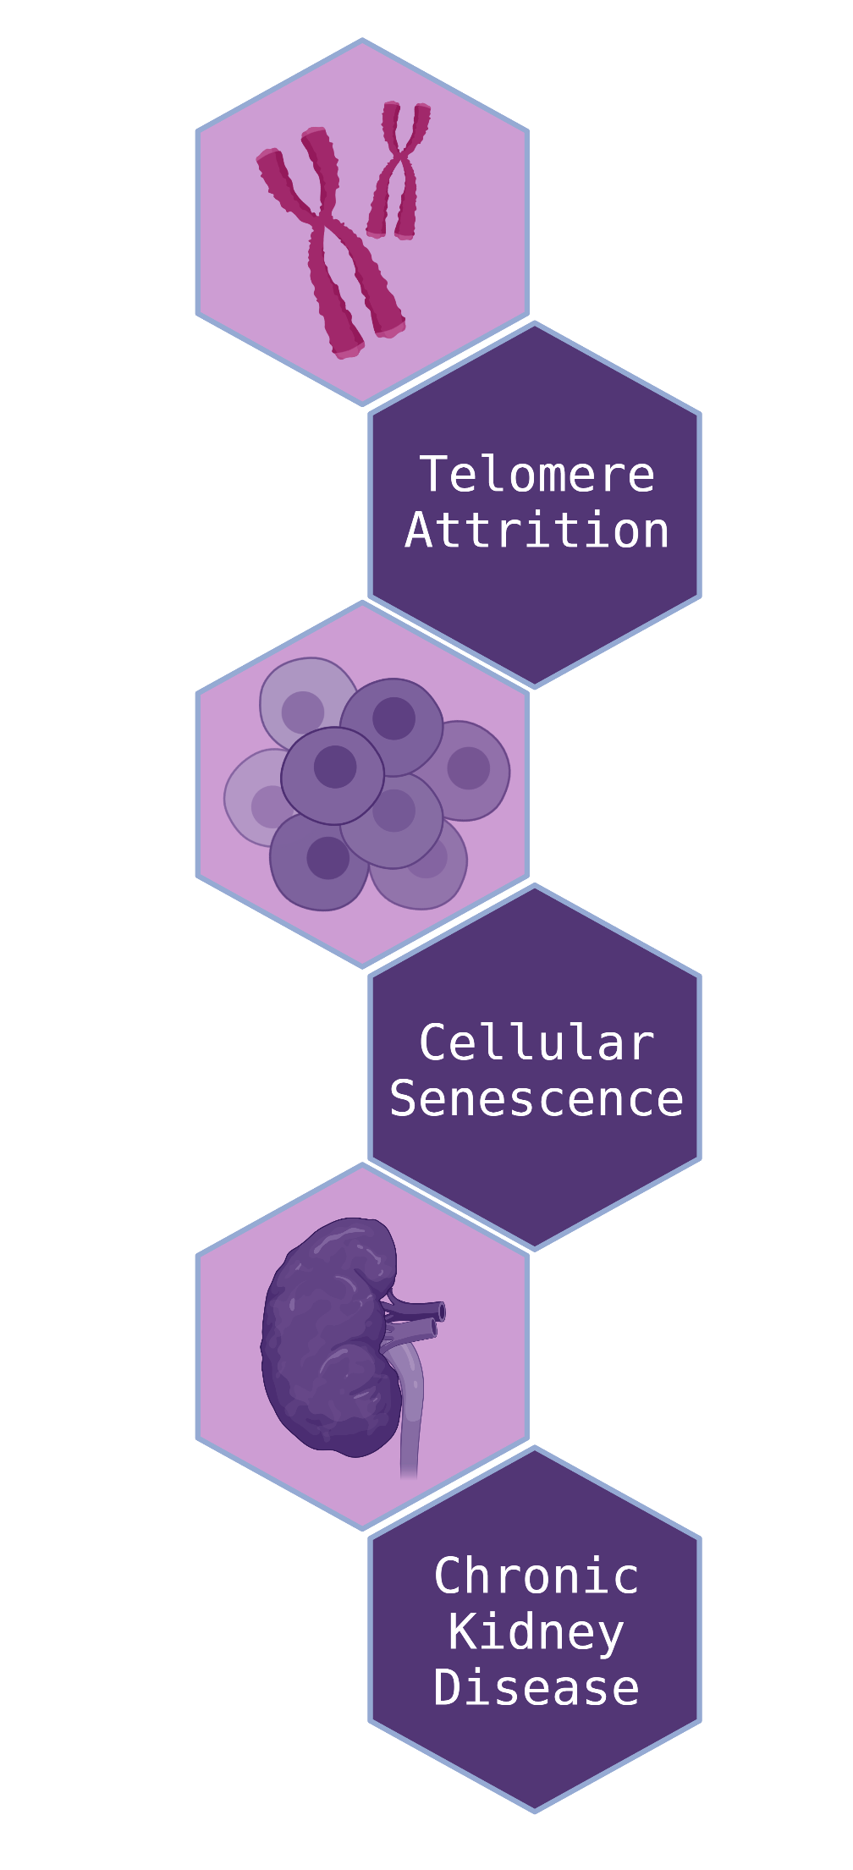
Telomeres and CKD
Critical Telomere Length → Cellular Senescence [8]
A senescent cell is a cell that is too biologically old to reproduce, but is still metabolically active [9]
Quantity of Senescent cells ∝ Severity of CKD [10, 11]
Potential for Telomere attrition to cause CKD
Literature on topic heavily conflicting [12-17]
Current datasets may not be powerful enough
We need better ways to measure telomeres
Notes:
Returning to the briefly mentioned idea of critical length, it has been found that once a telomere shortens past a particular threshold, it triggers a series of mechanisms leading to a cell becoming senescent. Cellular senescence is when a cell remains metabolically active, yet becomes unable to divide further, essentially stopping the cell cycle. To link this cellular senescence, and thus telomere length, back to kidney disease, it has been found that the presence of senescent cells has been found to correlate with progressing CKD. The later the CKD stage, the more senescent cells there are within the renal tissue. This is a key indication that telomere attrition may be a causal factor for CKD. There have been many studies investigating the causal role of telomere length in CKD, but there have been conflicting results within those that are published. With such conflicting results, it suggests that the techniques we have for measuring telomere length are not robust enough to produce consistent data.

Slide 6
Telomere Measurement
Large number of different techniques [18]:
Can broadly be divided into 2 groups, each with unique weaknesses
Group: | Group 1 | Group 2
Techniques: | qPCR, Southern Blot (Terminal Restriction Fragment), Q-FISH, FLOW-FISH | Single Telomere Length Analysis (STELA), universal-STELA, Telomere Shortest Length Assay (TeSLA)
General Action | Provides average or relative telomere lengths for all chromosomes in a cell. | Can measure telomeres on specific chromosomes. Can measure the shortest telomere in a cell.
Drawbacks | Can’t record lengths of individual telomeres* | High labour intensity, low throughput. Unable to measure ultra-long telomeres and may not work on all chromosomes.
*May slow research into the role of telomere attrition in disease, as the shortest telomeres in a cell are what determines how the cell behaves
Notes:
Telomere length has been measured in the past using many different techniques. The techniques have been well recorded in the literature, with each having their own strengths and weaknesses. The techniques can be broadly grouped into 2 categories. One group of techniques contains methods like Q-PCR, Southern Blot, Q-fish or Flow-fish. These techniques provide the average or relative telomere length of all the chromosomes in a cell yet are unable to measure singular telomeres on specific chromosomes. Recording the average telomere length across all the chromosomes in a cell is a major drawback for the purpose of investigating the role of telomere attrition in disease, as it is the shortest telomeres in a cell that determine the cells fate, not the average length across all of them.
The second category contains techniques like Single Telomere Length Analysis (STELA), universal-STELA and Telomere Shortest Length Assays (TeSLA). This allowed them to measure the shortest telomere in cells, providing a quantitative length rather than relative. However, they had an equally restrictive set of limitations, including a high labour intensity, low throughput, or the inability to measure ultra-long telomeres to be utilised on all chromosomes.

Slide 7
Method Review
Many review articles discuss the range of methods for telomere measurement [18-21]
To our knowledge, the most recent was published in 2018 [18]:
A lot of progress in the field over the last 5 years!
A new review article will be produced as part of the studentship
Discuss new changes and discoveries in existing methods
Highlight newly developed techniques, and their purpose
Explore the potential of Oxford Nanopore Telomere Sequencing
Notes:
These techniques have been discussed in various review articles, with the most recent being from 2018. There has been a great deal of development in the field of telomere length measurement since the publication of the last review, and as such that brings us to the first main product of this studentship. Since the start of the studentship, I have been reviewing the literature and developments within this field since the previous review for the purpose of creating a new review article. In this article, I hope to build upon the previous review’s descriptions of existing methods, highlighting the new strengths, weaknesses, and prior unknown potential of each. I will then explore entirely novel techniques in this review, one of which is the key focus of this studentship: Oxford Nanopore Telomere Sequencing.

Slide 8
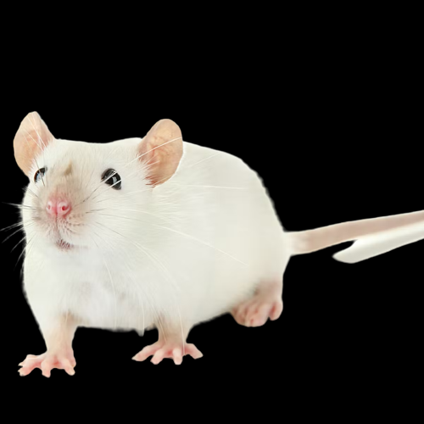
Oxford Nanopore Sequencing
Oxford Nanopore Telomere Sequencing – “NanoTelSeq”
New tool for measuring single telomeres
First discussed by Dr Riham Smoom and her research team [22]
Developed alongside a mouse model with human length telomeres – Telomouse [22]
Developed because existing tools were too labour intensive or could not measure super long telomeres
NanoTelSeq can very precisely read both super long telomeres, and super short telomeres
Notes:
What is Oxford Nanopore Telomere Sequencing, or NanoTelSeq as we’ll call it from this point, and where did it come from. NanoTelSeq is a novel method for analysing single telomere analysis through using Oxford Nanopore Sequencers. This technique was first discussed in a pre-print paper by Dr Riham Smoom at the Hebrew University of Jerusalem, where the team behind the paper utilised it for the purpose of measuring telomeres in a mouse model with human length telomeres, which they named “telomouse”. This tool was developed for the purpose of being able to read the ultra-long telomeres that were generated in the mouse model, as the other techniques at the time were either too labour intensive, or unable to read the ultra-long telomeres. The technique not only enabled the reading of ultra-long telomeres but enabled the identification and analysis of ultra-short telomeres, at the resolution of single-base-pair.

Slide 9
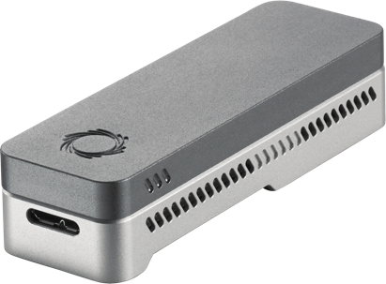
How Does NanoTelSeq Work?
Telomeres have an overhanging sequence of single strand DNA
A “Telorette” is attached to the overhang
Acts like a “barcode” – Genetic Barcoding
Different telorettes have different sequences, allowing the machine to identify them
The telorette must be attached to an adaptor that the sequencer can detect
The sequencer’s reads can extend from the adaptor to DNA on the other side of the telomere
Ensures full read of telomere
Reading DNA past the telomere allows us to tell what chromosome the telomere came from
Sequencer Read
Notes:
So, how does NanoTelSeq work? Well, telomeres have an overhanging sequence of single-stranded DNA at either end. A special genetic sequence called a “telorette” has to be attached to the overhanging sequence at the end of a telomere. There are a number of different telorettes, each with a slightly different sequence, and these small differences can allow for genetic barcoding. By attaching different telorettes to different samples, multiple samples can be run through the sequencer at the same time, and when the sequencer reads the samples, the telorettes act as “barcodes” that allow each telomere’s sample of origin to be identified. However, the telorette alone is not enough to begin sequencing the samples. The telorette, and by extension the telomere, must be linked to a nanopore sequencing adapter, which will allow it to be detected and fed through the pores of the Oxford Nanopore Sequencer. The Nanopore sequencer is capable of reading the samples from the end containing the adapter, all the way through the telomere to the other end, even reading as far as the non-repeating sub-telomeric DNA. By being able to read both the adapter, and sub-telomeric region, it ensures that the entire telomere is recorded in the middle of the read, allowing the full quantification of the telomere, without any of it being missing from the read. Furthermore, including a section of sub-telomeric DNA in the read allows us to tell which chromosome the telomere came from, as the subtelomeric DNA will be unique to each chromosome.

Slide 10
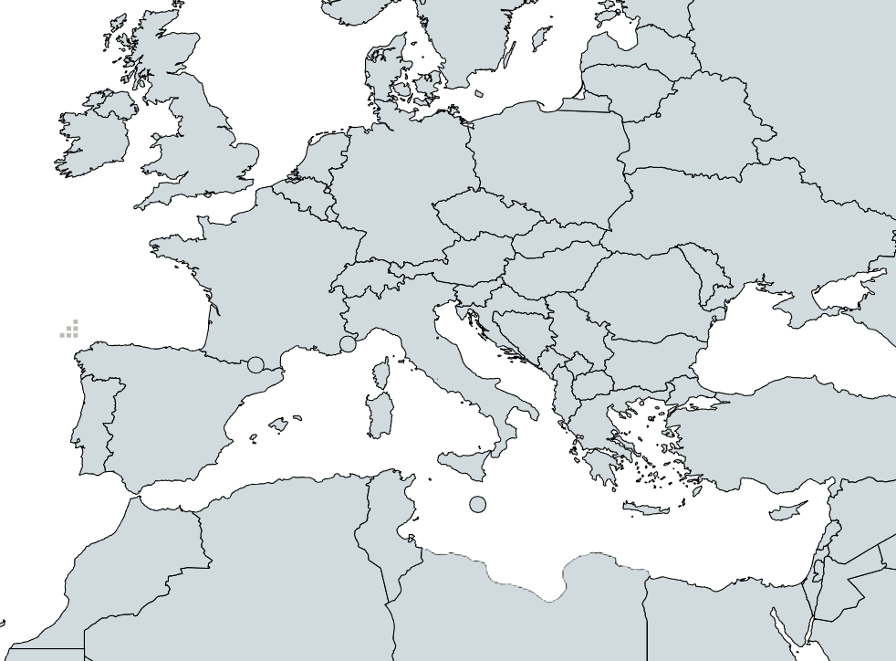
Bringing NanoTelSeq to Belfast!
Multiple steps to bring the method to Belfast:
Original method used on mouse DNA; tweaks needed for human DNA
International communications established
Smoom’s teams' expertise and knowledge
Initial trials will use control samples to check the method is working as intended
Samples from patients with kidney disease to be used once methods perfected
Notes:
Bringing this technique to the MEPH labs has been a large multi-step process. The protocol developed by Smoom et al has had to be adapted for human samples. To achieve this, my supervisor and I have spent the first three weeks refining and ironing out the protocol. This refinement process involved establishing communication with Smoom and her team for the purpose of using their insight and experience to aid us in adapting the protocol. Through this, we managed to establish a protocol for NanoTelSeq within our labs This adapted protocol will be first used alongside control samples to test the functionality and practicality of the technique. We expect the majority of the studentship to be devoted to establishing the procedure, and troubleshooting any bumps in the road that will occur during the initial trials. Depending on time, we hope to then be able to take the protocol and apply it to samples from individuals with kidney disease, generating data that will allow for comparisons of their telomere lengths with matched healthy controls for the first ever time at chromosome and base-pair resolution.

Slide 11
Future Directions
This studentship opens many future possibilities:
The review produced will help researchers decide what method of telomere measurement is best for them
Setting up NanoTelSeq will allow us to better research the telomere’s role in CKD
Learning to implement this new workflow will further train all staff involved in the procedure and generate new background information for future substantial funding
Ultimately, this studentship aims to be another step towards reduce CKD’s global burden, for the patients who need it most
Notes:
Regardless of whether or not time allows for sequencing samples from any of the MEPH’s kidney disease cohort, this implemented workflow will open many future avenues of research. Firstly, the review that will have been produced as part of this studentship will help inform researchers what method of telomere length best fits the needs of their research. This project will also potentiate future grant applications for research projects that want to use NanoTelSeq to investigate how telomere length varies in kidney disease. The data generated by these future studies will further build upon the understanding of how telomere length disrupts biological processes. In conclusion, this studentship is implementing new techniques that will down-the-line increase our understanding of kidney disease, furthering the paramount goal of reducing the global burden of this disease on our healthcare services, and our patients who need it most.

Slide 12
Without research there is no progress and without progress there is no hope.
Notes:
Thank you very much for your attention during this presentation. I do hope you found it interesting, if you have any questions after watching, or even just want to find out more, please don’t hesitate to email your questions to me. I have attached my email on this final slide. Thank you once more, and I hope you enjoy the rest of the symposium.

Slide 13
If you have any questions, please don’t hesitate to email: tcoulter03@qub.ac.uk
nephres@qub.ac.uk
Notes:
Thank you very much for your attention during this presentation. I do hope you found it interesting, if you have any questions after watching, or even just want to find out more, please don’t hesitate to email your questions to me. I have attached my email on this final slide. Thank you once more, and I hope you enjoy the rest of the symposium.

Slide 14
Bibliography
1. Group IGODW. KDIGO 2020 Clinical Practice Guideline for Diabetes Management in Chronic Kidney Disease. 2020;
2. Ekanayake IU, Herath D. Chronic Kidney Disease Prediction Using Machine Learning Methods. MERCon 2020 - 6th International Multidisciplinary Moratuwa Engineering Research Conference, Proceedings. 2020 Jul 1;260–5.
3. Foreman KJ, Marquez N, Dolgert A, Fukutaki K, Fullman N, McGaughey M, et al. Forecasting life expectancy, years of life lost, and all-cause and cause-specific mortality for 250 causes of death: reference and alternative scenarios for 2016–40 for 195 countries and territories. The Lancet. 2018 Jul;392(10159):2052–90.
4. Kidney Research UK. Economics of Kidney Disease [Internet]. 2023 [cited 2023 Jul 3]. Available from: https://www.kidneyresearchuk.org/wp- content/uploads/2023/06/Economics-of-Kidney-Disease-full-report_accessible.pdf
5. Soudet J, Jolivet P, Teixeira MT. Elucidation of the DNA end-replication problem in Saccharomyces cerevisiae. Mol Cell. 2014 Jul;53(6):954–64.
6. Shay JW. Role of Telomeres and Telomerase in Aging and Cancer.
7. Levstek T, Podkrajšek KT. Telomere Attrition in Chronic Kidney Diseases. Antioxidants 2023, Vol 12, Page 579. 2023 Jul;12(3):579.
8. Shay J. The role of telomeres and telomerase in the pathology of human cancer and aging: Pathology: Vol 38, No 2.
9. Roger L, Tomas F, Gire V. Mechanisms and Regulation of Cellular Senescence. Int J Mol Sci. 2021 Jul;22(23).
10. Kitada K, Nakano D, Ohsaki H, Hitomi H, Minamino T, Yatabe J, et al. Hyperglycemia causes cellular senescence via a SGLT2- and p21-dependent pathway in proximal tubules in the early stage of diabetic nephropathy. J Diabetes Complications. 2014;28(5):604–11.
11. Docherty MH, Baird DP, Hughes J, Ferenbach DA. Cellular Senescence and Senotherapies in the Kidney: Current Evidence and Future Directions. Front Pharmacol. 2020 Jul;11:755.
12. Bansal N, Whooley MA, Regan M, McCulloch CE, Ix JH, Epel E, et al. Association between kidney function and telomere length: the Heart and Soul Study. Am J Nephrol. 2012 Jul;36(5):405.
13. Astrup AS, Tarnow L, Jorsal A, Lajer M, Nzietchueng R, Benetos A, et al. Telomere length predicts all-cause mortality in patients with type 1 diabetes. Diabetologia. 2010;53:45–8.
14. Fyhrquist F, Tiitu A, Saijonmaa O, Forsblom C, Groop PH. Telomere length and progression of diabetic nephropathy in patients with type 1 diabetes. J Intern Med. 2010 Jul;267(3):278–86.
15. Fazzini F, Lamina C, Raschenberger J, Schultheiss UT, Kotsis F, Schönherr S, et al. Results from the German Chronic Kidney Disease (GCKD) study support association of relative telomere length with mortality in a large cohort of patients with moderate chronic kidney disease. Kidney Int. 2020 Jul;98(2):488–97.
16. Gurung RL, M Y, Liu S, Liu JJ, Lim SC. Short Leukocyte Telomere Length Predicts Albuminuria Progression in Individuals With Type 2 Diabetes. Kidney Int Rep. 2017 Jul;3(3):592– 601.
17. Park S, Lee S, Kim Y, Cho S, Kim K, Kim YC, et al. A Mendelian randomization study found causal linkage between telomere attrition and chronic kidney disease. Kidney Int. 2021 Jul;100(5):1063–70.
18. Shay JW, Lai TP, Wright WE. Comparison of telomere length measurement methods.
19. Aubert G, Hills M, Lansdorp PM. Telomere length measurement-caveats and a critical assessment of the available technologies and tools. Mutat Res. 2012 Feb 1;730(1–2):59– 67.
20. Nussey DH, Baird D, Barrett E, Boner W, Fairlie J, Gemmell N, et al. Measuring telomere length and telomere dynamics in evolutionary biology and ecology. Methods Ecol Evol. 2014;5(4):299–310.
21. Nakagawa S, Gemmell NJ, Burke T. Measuring vertebrate telomeres: applications and limitations. Mol Ecol. 2004 Sep;13(9):2523–33.
22. Smoom R, May C, Ortiz V, Tigue M, Kolev H, Rowe M, et al. Telomouse -a mouse model with human-length telomeres generated by a single amino acid change in RTEL1. 2023.

