Slide 1

NI Transplantation
NI Kidney Research Fund
Annual General Meeting
17 September 2025
Aisling Courtney
Transplant Nephrologist

Slide 2
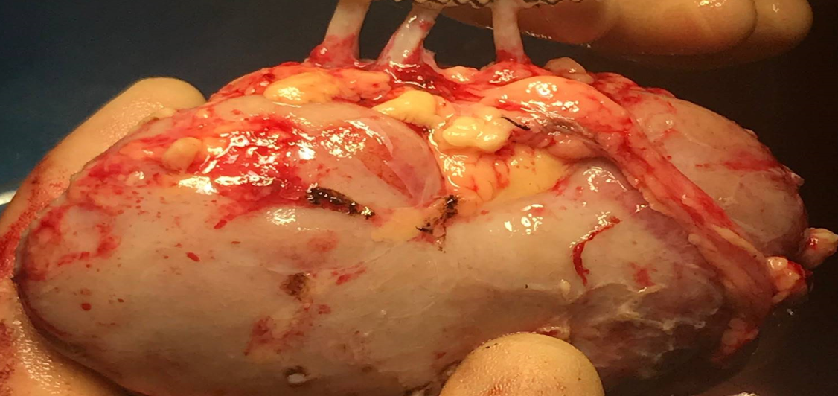

Slide 3
Transplant numbers

Slide 4
Belfast transplants
n=93
2018-2023 mean 112
Excluding 2020
Notes:
Excluding 2020: 2018, 2019, 2021, 2022 mean = 111
With 2020 = 120

Slide 5
Belfast transplants
Northern Ireland n=83
fewest NI patients
since 2011
Notes:
Excluding 2020: 2018, 2019, 2021, 2022 mean = 111
With 2020 = 120

Slide 6
LD transplants
LD = 58

Slide 7
Deceased donor transplants
DBD = 18
DCD = 17
Notes:
Equivalent DBD and DCD for first in 3 year
Fewest DBD since 1970
Fewest DD since 2011 - 34

Slide 8
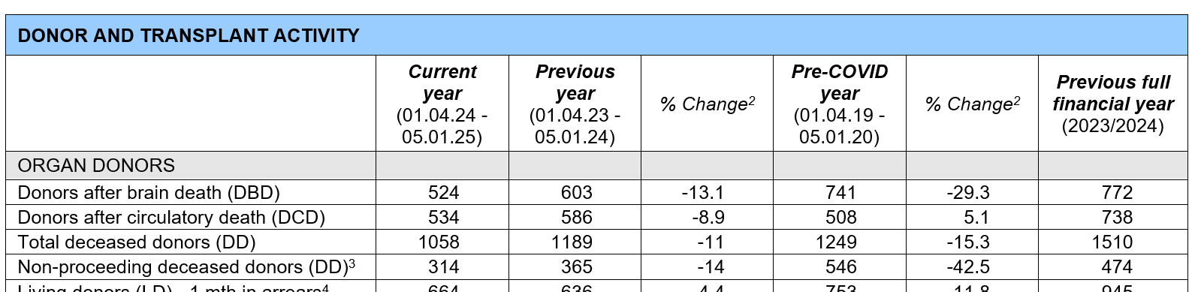

Slide 9
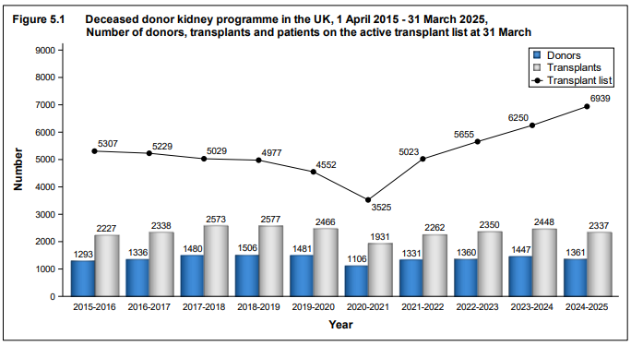

Slide 10
Waiting list

Slide 11
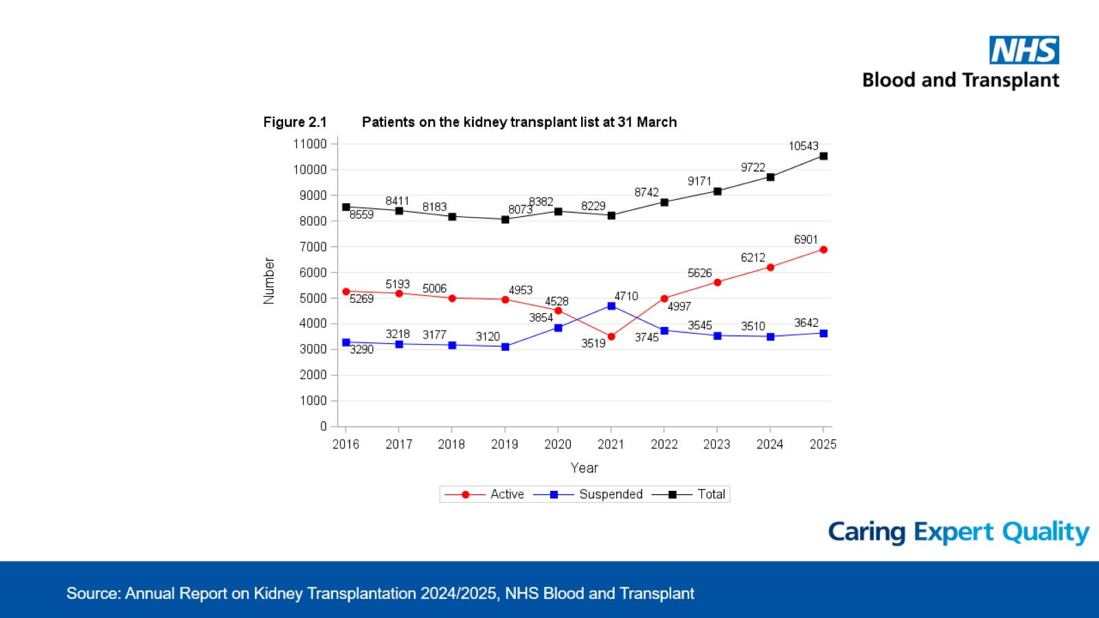

Slide 12
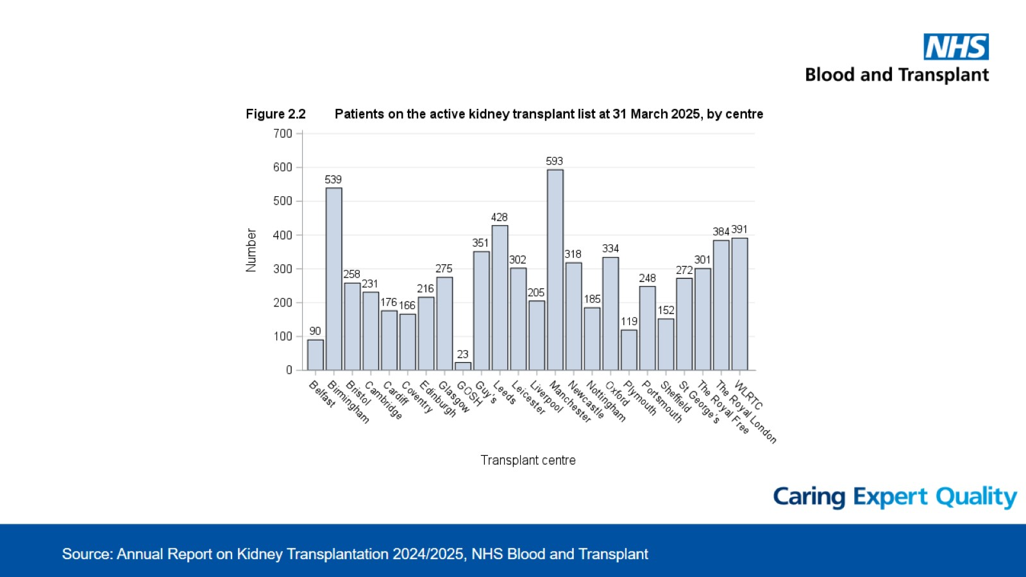

Slide 13
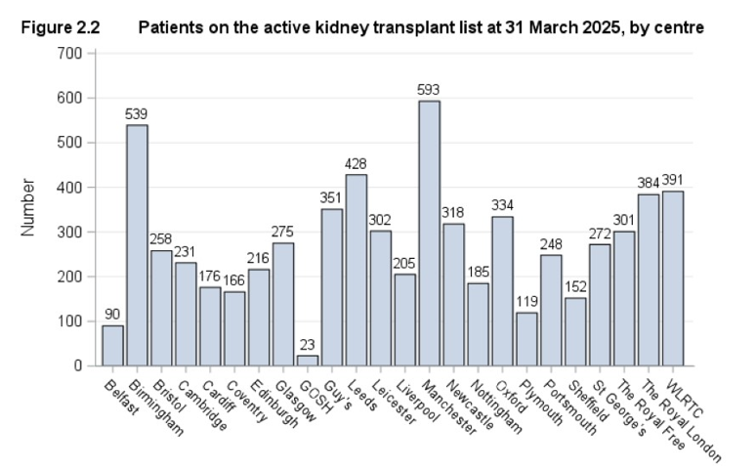
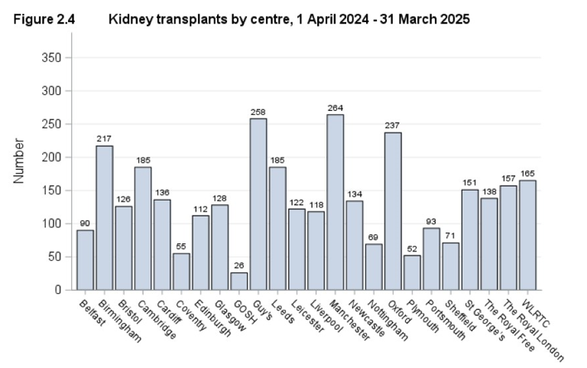

Slide 14
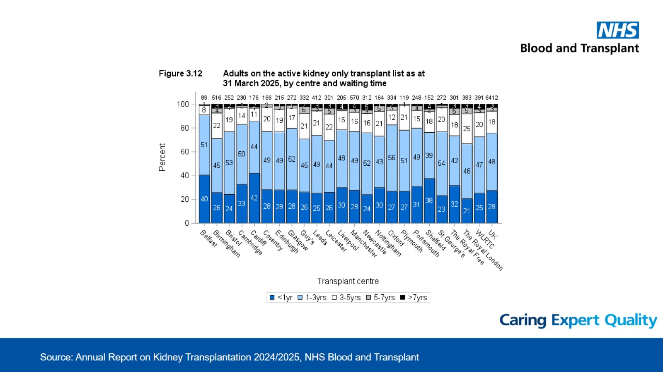

Slide 15
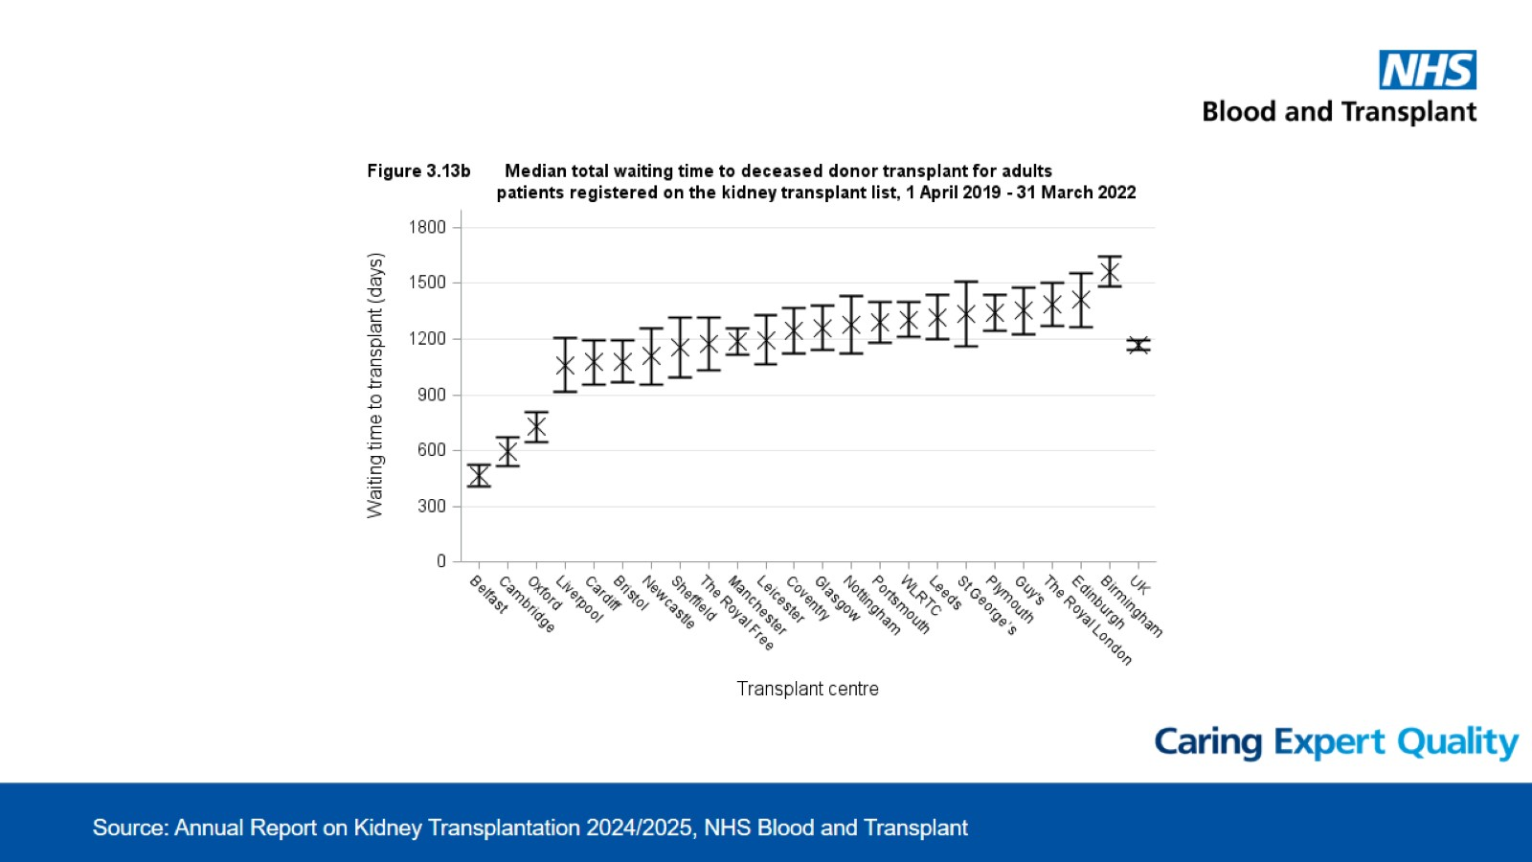

Slide 16
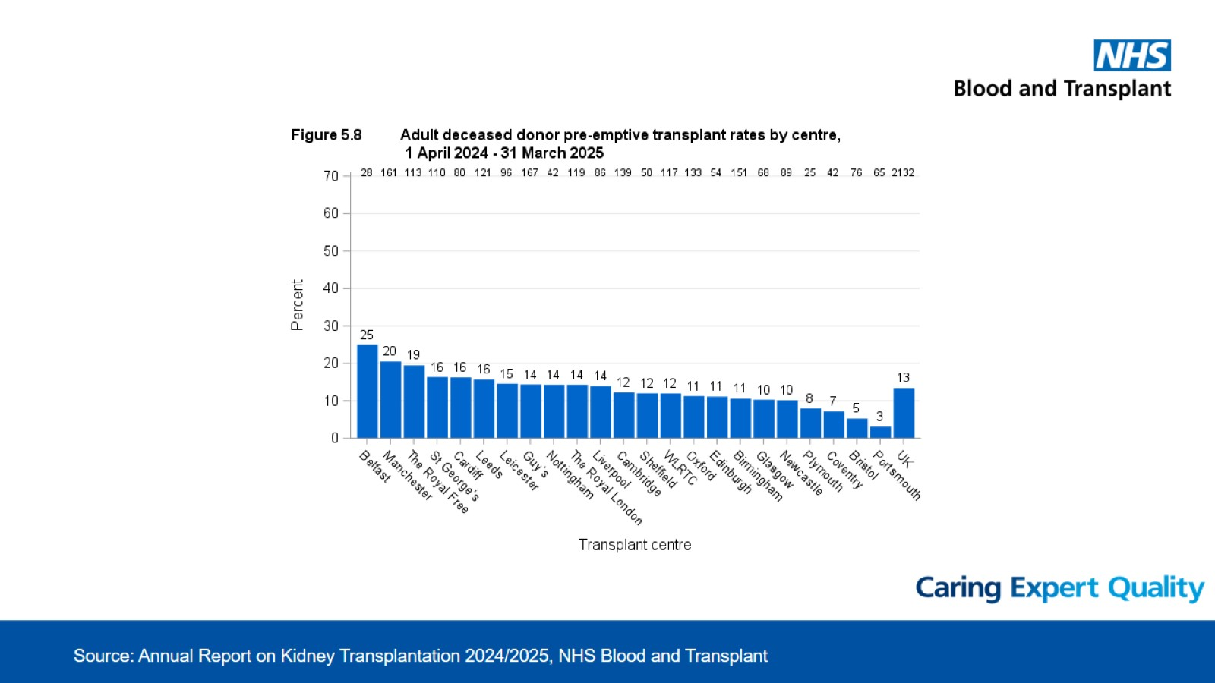

Slide 17
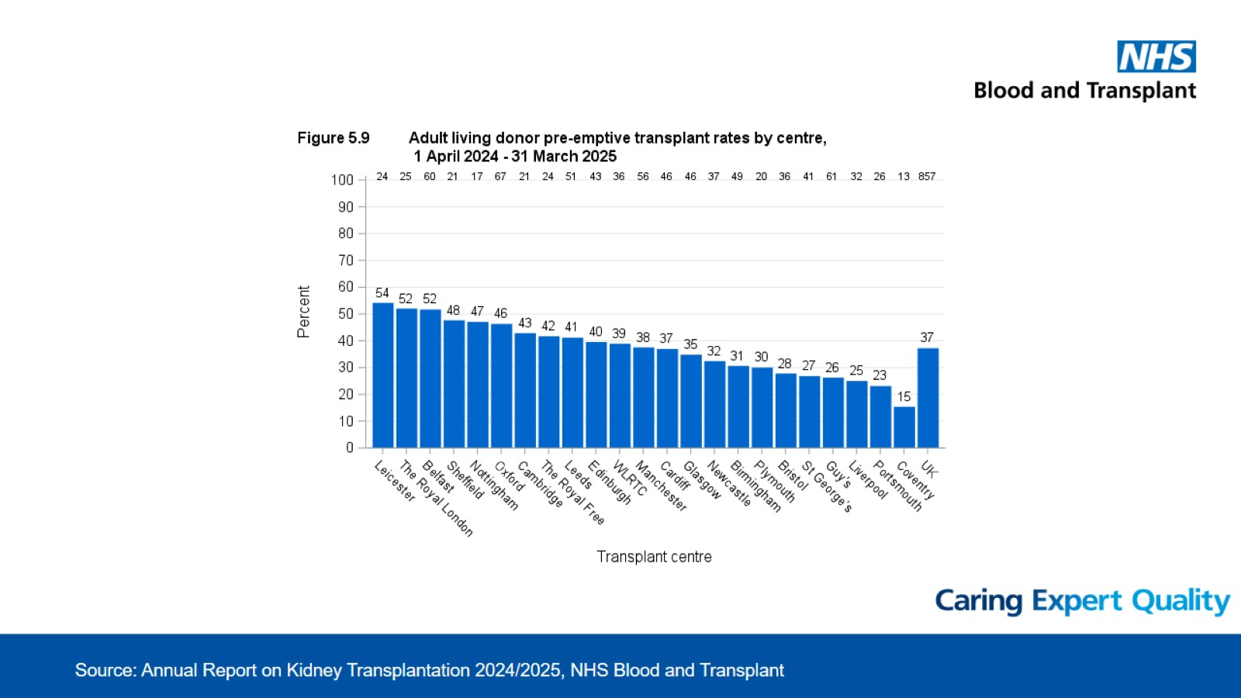

Slide 18
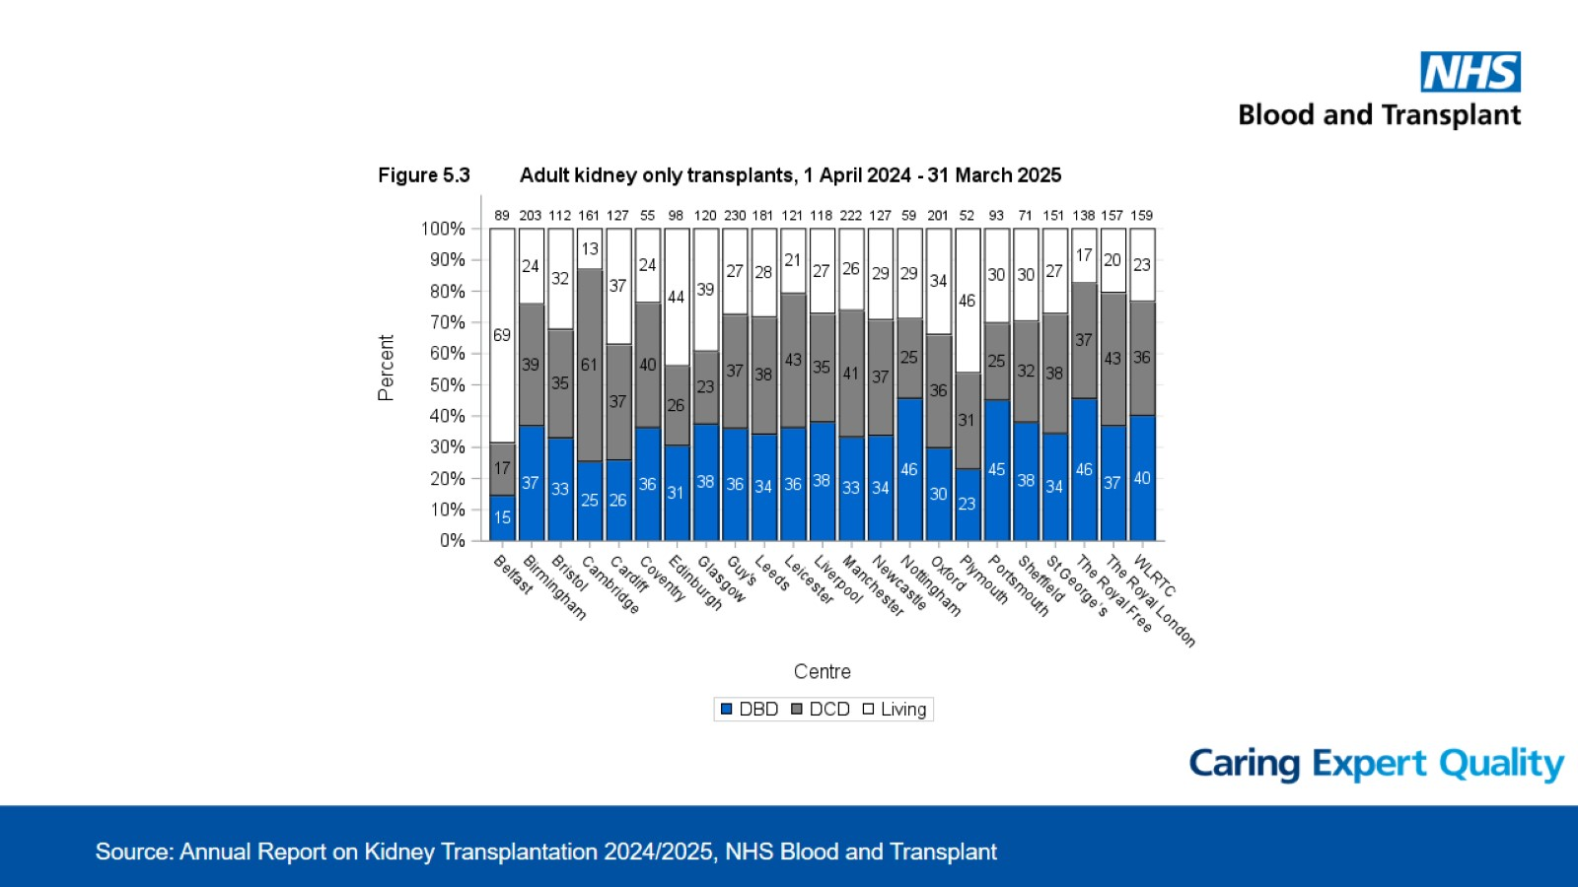

Slide 19
Living donors

Slide 20
LD transplants

Slide 21
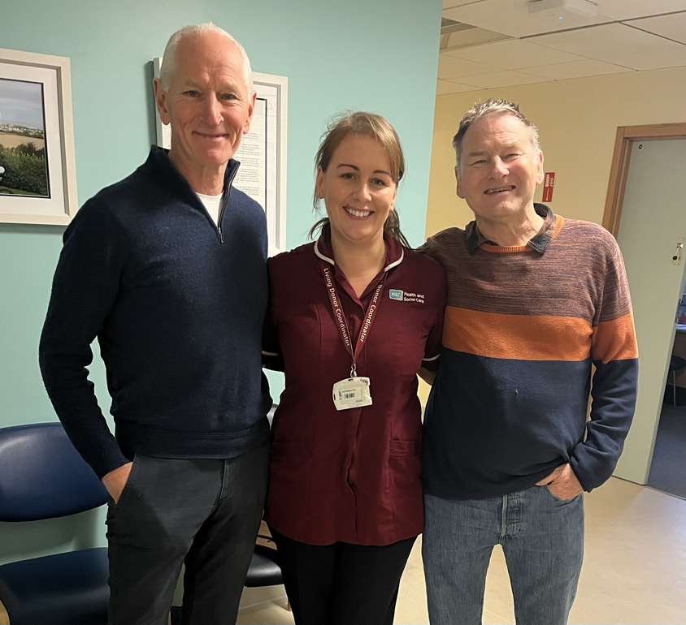

Slide 22
Kidney Sharing Scheme
+15 so far 2025
Notes:
3 RoI, not highly sensitised – Denis Buckley, Jason O’Connor, Mark Tierney

Slide 23
Kidney Sharing Scheme
n=169
Notes:
2023 n=10 numerically smallest since 2014 (except for 2020)
2024 n=15

Slide 24
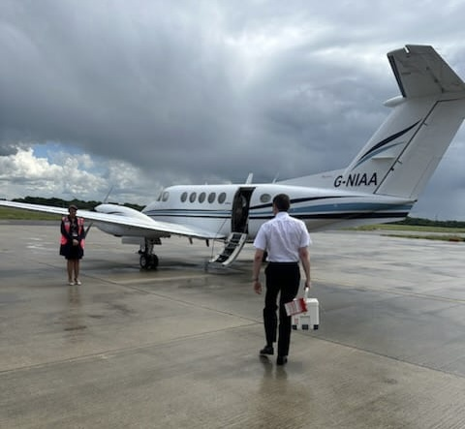
Notes:
Charter flight with kidney – Megan Moore 2024, 000000

Slide 25
LD transplants
Additional 99 altruistic

Slide 26

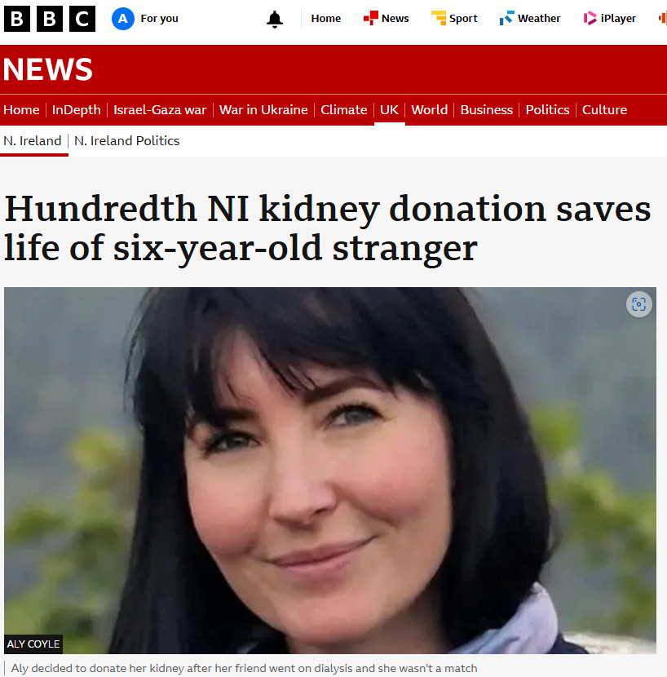
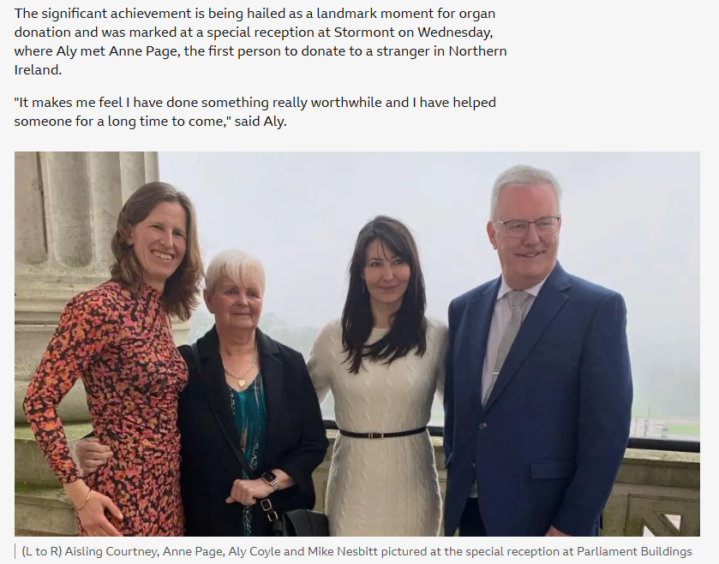

Slide 27
Living donors to 17 September

Slide 28
The rest of Ireland

Slide 29
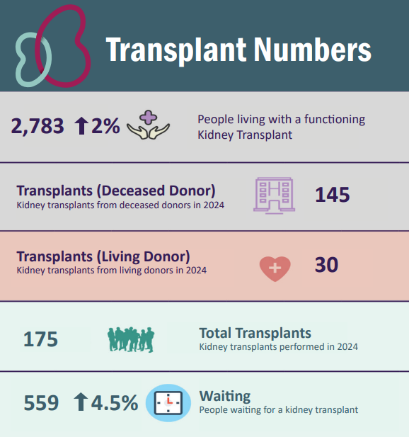
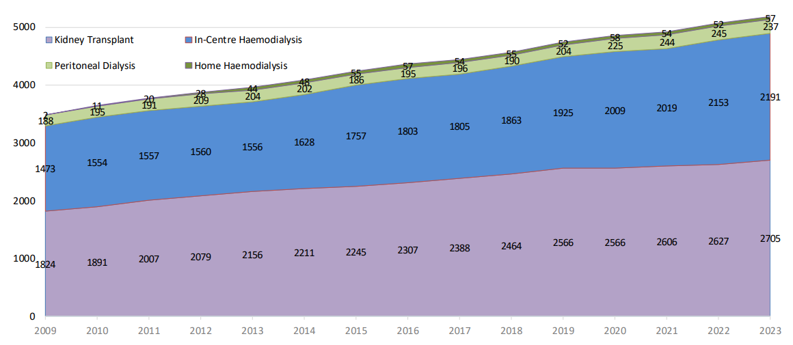
Dialysis Numbers
Clinical Renal Office: Clinical Programme Update 2023

Slide 30
Republic of Ireland
n=24
18 via KSS
12 ABO incompatible
7 KSS
5 direct
2 HLAi and ABOi in KSS

Slide 31
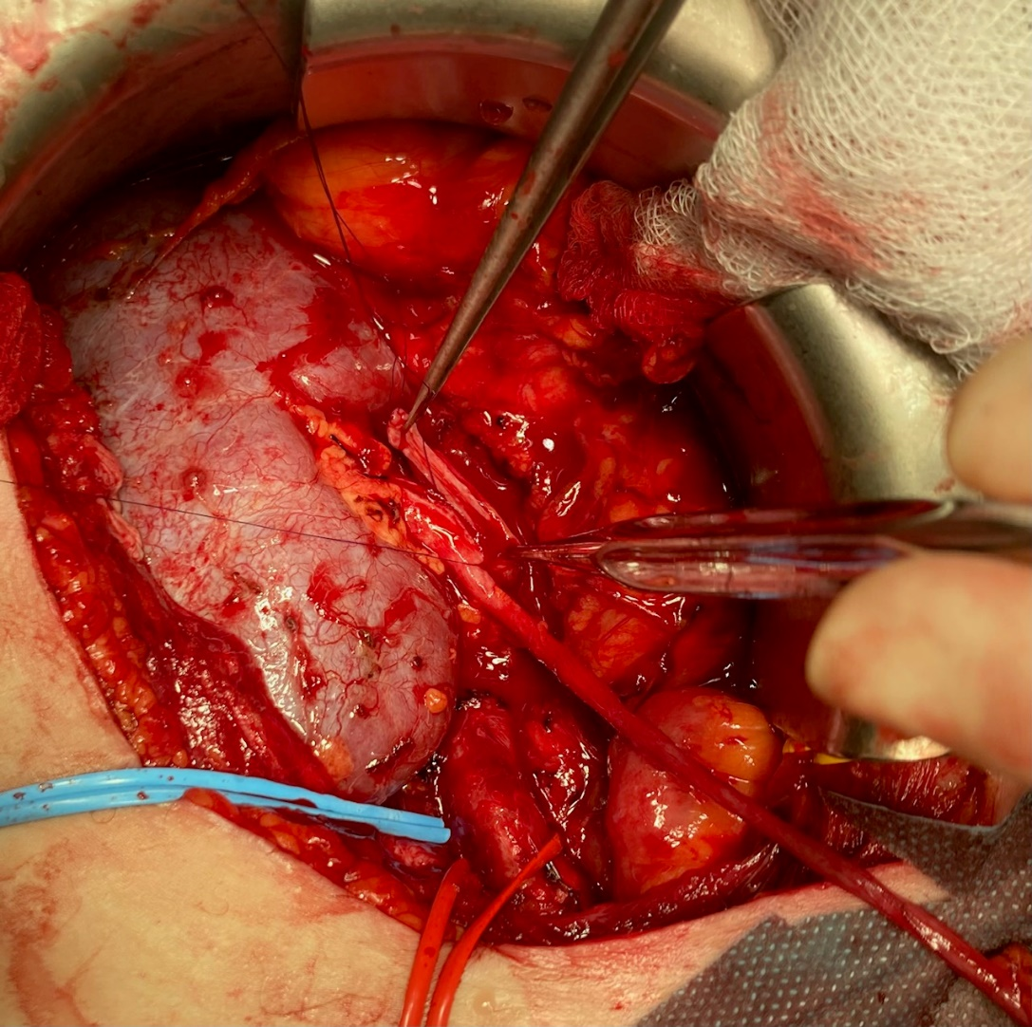
April 2025
48 years old
On dialysis 17 years (2008)
Two previous transplants
Hard to match
Eligible for only 6 / 10 000 donors
Not on deceased donor waiting list
Living donor in Poland
3-way exchange
6 operations
5-days of treatment

Slide 32
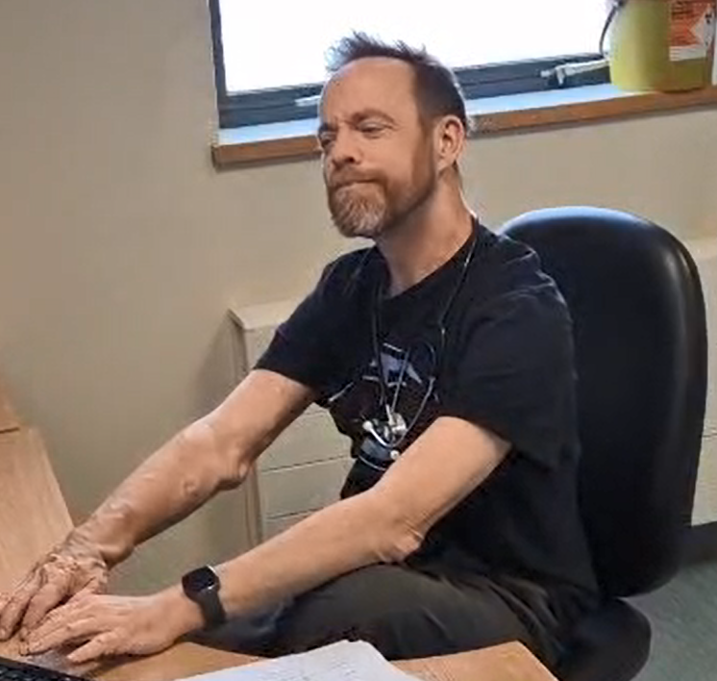
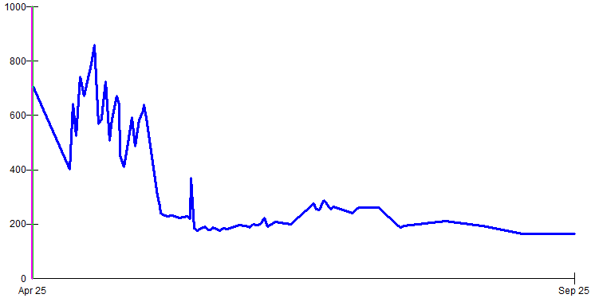
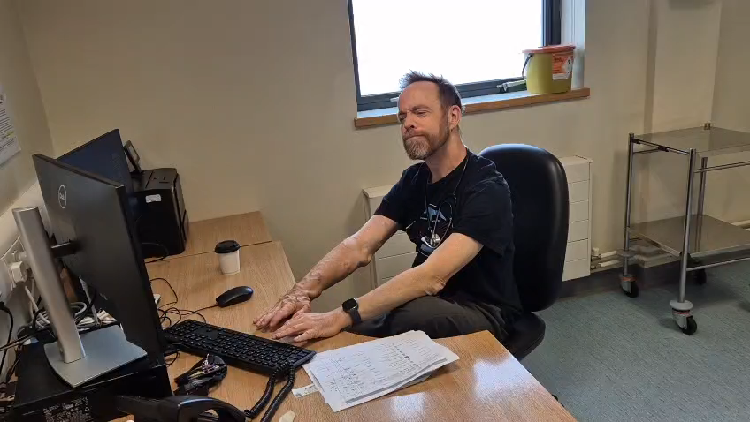
September 2025
creatinine

Slide 33
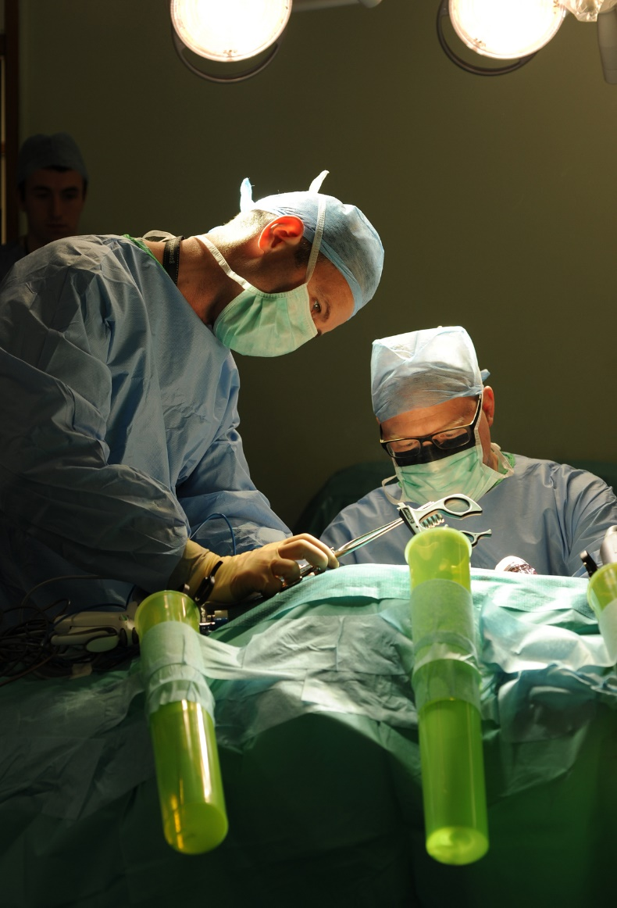
Staff
Lab
Nurses
Surgeons
Nephrologists
Trainees
Coordinators
Administrative
Domestic

Slide 34
Summary
Transplantation is always challenging
Belfast continues to lead the way in both deceased and living donor transplantation in UK and beyond
Reflection of extraordinary teamwork, including support from NIKRF

Slide 35
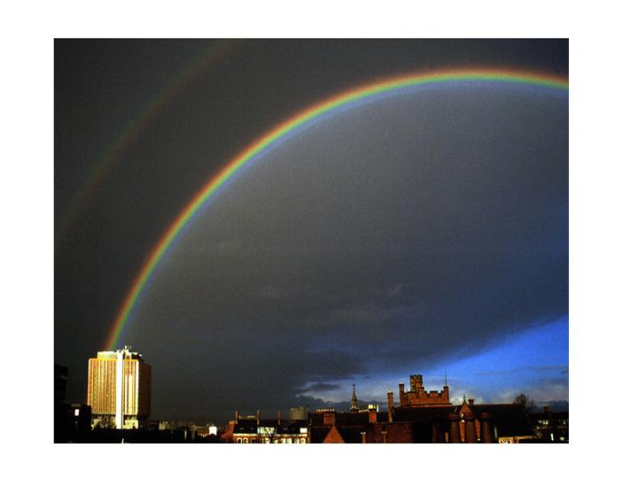

Slide 36
