Slide 1



Why do some kidney diseases recur following kidney transplantation?
A review of glomerulonephritis in Northern Ireland (NI) and assessment of the implications for recurrent glomerulonephritis in kidney transplant recipients.
Dr Samuel Bell
1 month into a funded Clinical Academic Fellowship / PhD supported by NIKRF, so very much in the planning and initial stages!
Background:
Glomerulonephritis is a leading cause of end-stage kidney disease (ESKD), particularly in young patients. After kidney transplantation it has a chance of recurring, leading to accelerated kidney transplant loss and a return to dialysis / need for further transplants in affected individuals.
The goal of my PhD is to understand the impact of glomerulonephritis in Northern Ireland, risks associated with progression to ESKD, and the risks and factors associated with the disease coming back in the transplanted kidney.
Part 1:
A review of biopsy practices and native glomerulonephritis in NI, 2006-2025
Currently collating all kidney biopsies performed in NI between 2006-2025
Will be organised by diagnosis and compared to previous published NI data (Hanko et al, 2009)
Clinical data, biochemistry data, and socioeconomic data will be analysed to ascertain:
Rates of progression
Risk factors for progression
Impact of new therapies
Part 2:
A review of kidney transplant recipients who have reached ESKD due to glomerulonephritis
Identification of cohort through transplant database
Identification of those with recurrent disease (diagnosed on kidney transplant biopsy)
Utilisation of clinical data, biochemistry data, and socioeconomic data to ascertain:
Risk factors for recurrence and eventual loss of transplant
Role and timing of kidney transplant biopsy
Many thanks: Dr McKay, Professor Maxwell, Dr McClure, Dr Courtney, Professor O’Rourke, Professor Cardwell, NIKRF and many others to come!

Slide 2






Physical Activity for Children with Kidney Disease: The PACKD Study
Systematic Review
A systematic review of the effects of physical activity on physical activity levels and quality of life in children with chronic kidney disease (CKD).
Aim:
Establish the types and parameters of physical activity interventions for children with chronic kidney disease
Determine the effectiveness of physical activity interventions on:
physical activity levels
quality of life
Qualitative Research
Aim: To explore physical activity from the perspectives of children with CKD and their parent(s)/carer(s).
Objectives:
Explore views on being physically active
Identify barriers and facilitators to participation in physical activity
Identify important elements and outcomes of physical activity strategies/interventions
Prioritise physical activity strategies from the perspectives of children, their families, healthcare professionals and stakeholders.
Method: Phase 1 will utilise qualitative interviews with 15 children and their families. Phase 2 will involve the hosting of a Research World Café event with children and relevant stakeholders.
Dr Karen McConnell
Principal Investigator
Dr Lisa Maguire
Research Fellow
Update:
Systematic Review Protocol has been published
PROSPERO 2025 CRD420251034197
Ethics Submitted for Qualitative Research

Slide 3




NIKRF: UK Kidney Ecosystem project
NI is embedded in a speciality wide, systematic approach to minimise kidney failure - significant international collaboration
Complex & prolonged contracting complete!
Building a rare kidney disease registry & associated bioresource
Contributing bioresource and healthcare data from NI to UK-wide research, discovering diagnoses, & treatments
Ensuring the voices of children, young people, and their families across NI influence policy & care
Postdoc to be appointed on this project later this year / early 2026.
Notes:
This project is associated with the larger LifeArc-Kidney Research UK Centre for Rare Kidney Disease, which has pushed back all milestones by 6-9 months due to delays with complex contracting required across all contributors.

Slide 4
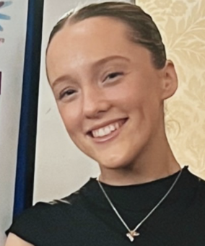

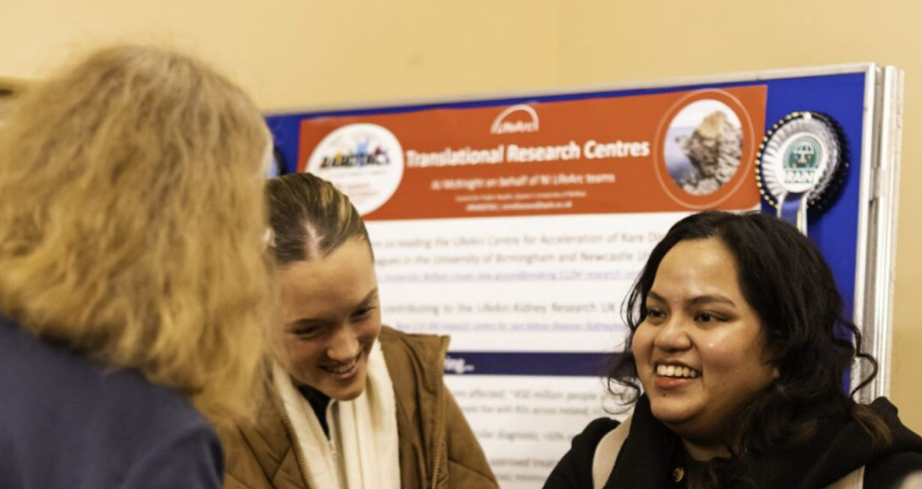
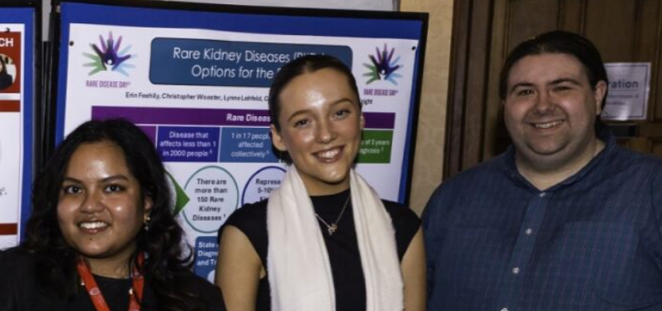

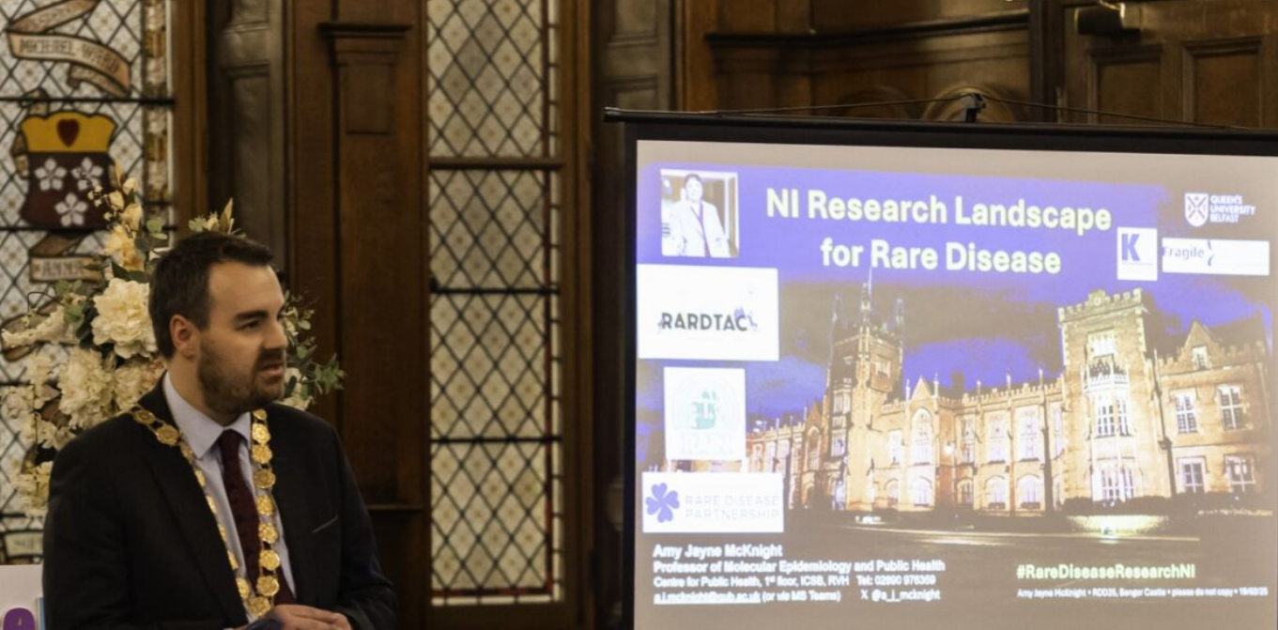
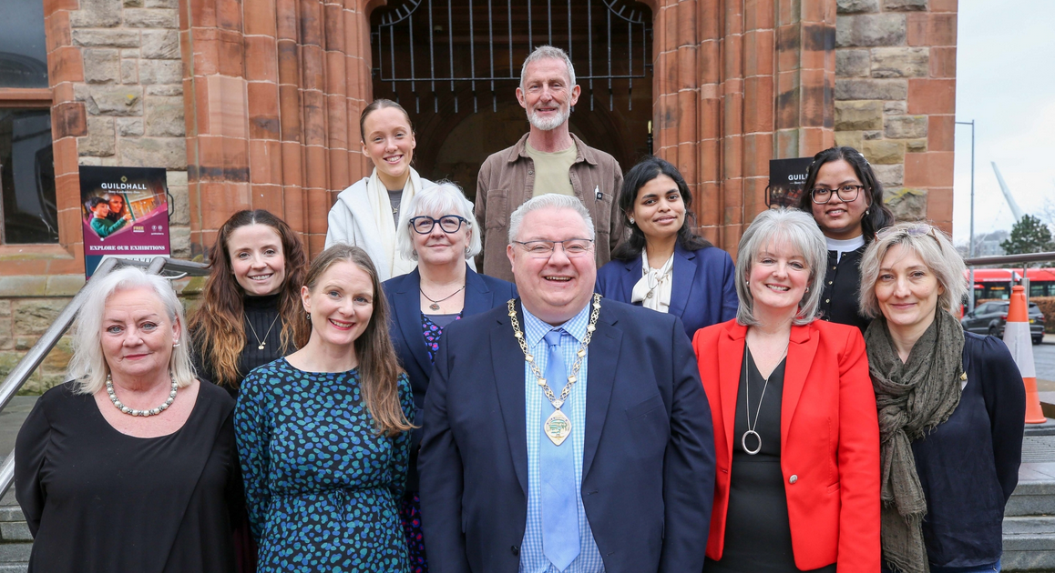

NIKRF-QUB PhD studentship: Erin
Innovative approaches to improve early detection, diagnosis, and treatment of rare kidney conditions: a transdisciplinary quantitative & qualitative approach
6 events raising awareness of kidney disease – meeting Mayors, MLAs, MPs, local councillors and communities. 2 newspaper articles; 2 reports. ‘A day in the life of’ video.
Defined rare kidney conditions
Reviewing state of the art approaches to diagnose kidney disease
Notes:
The supervisory team brings together expertise in laboratory analyses, molecular research, clinical genetics, and qualitative research spending time with people to understand their experiences and thoughts.
Erin Feehilly has been very involved in outreach activities, supporting raising awareness of rare kidney disease and NIKRF funded research at 6 community events, appearing in newspaper articles, and creating a short video showcasing a day in the life of her PhD research.
Emerging themes note delayed and often inaccurate diagnosis due to rare, overlapping symptoms + the strong potential for artificial intelligence and high-resolution imaging to support diagnosis and management of rare kidney diseases. Erin is also generating a summary of emerging approaches known as ‘multiomics’ that are being used to help diagnose rare kidney diseases.

Slide 5







Helena Brown 17 Sep 2025
NIKRF PhD Studentship: Helena
To Maximise participation of paediatric patients with rare kidney conditions in clinical trials: a creative arts approach
Improve the lives of children affected by rare kidney diseases
Research in NI needs to grow.
NI isolated COLLABORATE
GROWING
Supervised by AJ McKnight, Noleen McCorry and Franziska Shroeder
AIM
Investigate how creative (performing) arts can overcome barriers to participation in rare kidney research within NI.
Co-produce a portfolio of creative practice to increase awareness & understanding of kidney disorders in children & young adults – e.g. infographics, play, videos, podcasts, storytelling, immersive arts.
Co-design key messaging & adaptive guidelines to improve communication & understanding to maximise participation in clinical trials / research for kidney patients, their families, and healthcare professionals.
PROGRESS
Survey of Young Patient Action Groups throughout the UK – “Your Youth Research Group - Help us learn from you”
Ethical approval – application ready for submission - includes suite of documents prepared for workshops with children and young people to co-design establishment of NI PAG
Scoping review to identify gaps
UK Kidney Ecosystem – overview of research currently underway, including impact of ‘clinical trial’ ‘study’

Slide 6



View a short video of local kidney research
NIKRF: THANK YOU for your support
Notes:
Add link to our kidney videos…

Slide 7
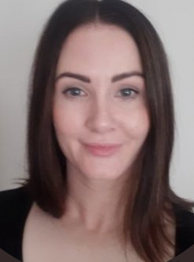

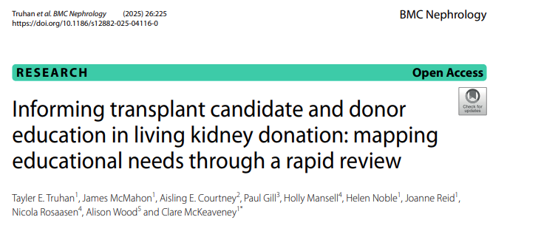
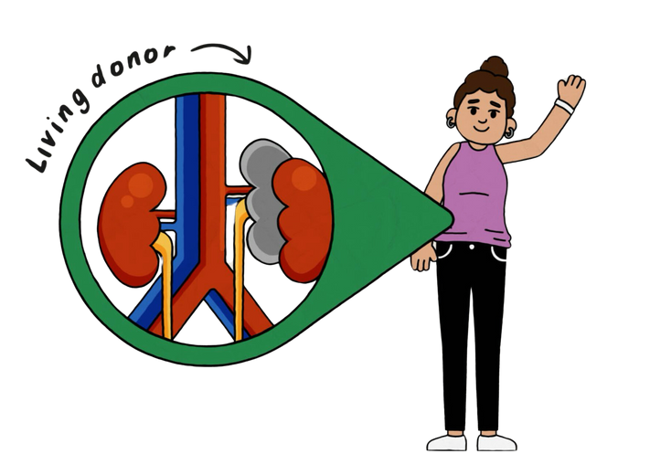
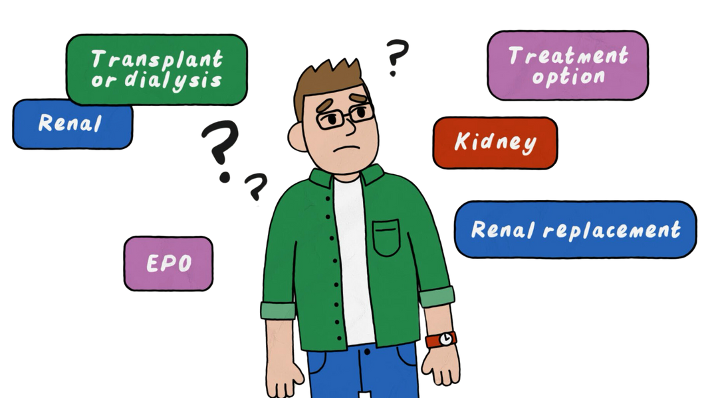

Using the ADAPT Guidance to Refine a Video Educational Series for Kidney Transplantation and Living Donation
Team: Dr Clare McKeaveney, Dr James McMahon, Professor Helen Noble, Professor Joanne Reid, Professor Paul Gill, Nicola Rosaasen, Dr Alison Wood, Professor Holly Mansell
Aim: The purpose of this study is to adapt a video educational series and evaluate improvements in patient knowledge and satisfaction.
Method: Following the ADAPT Framework, a co-design process was applied involving patients, donors and renal healthcare professionals to adapt and assess the video educational resource.
Update: New Research Fellow appointed Nov 2024 (Dr James McMahon). Rapid review of educational needs of kidney transplant patients and living donors published in BMC Nephrology. All live videos are in the final edits. Project extension granted to October 2025. Ethical and governance approval secured for Evaluation Study at BHSCT.
Completion date: October 2025

Slide 8



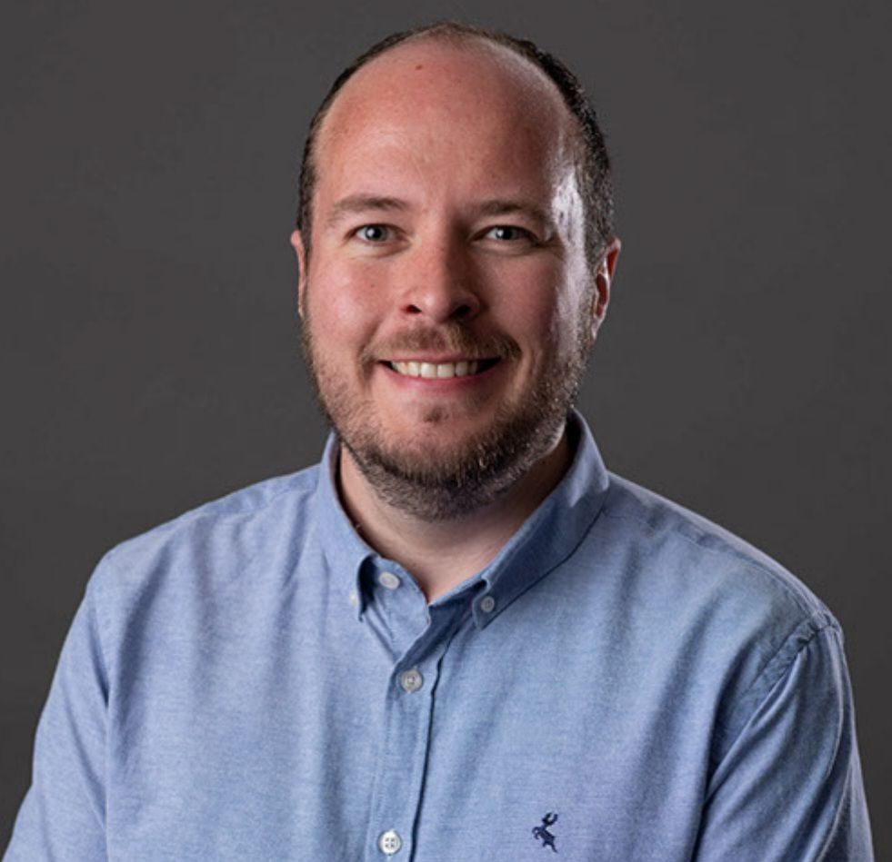


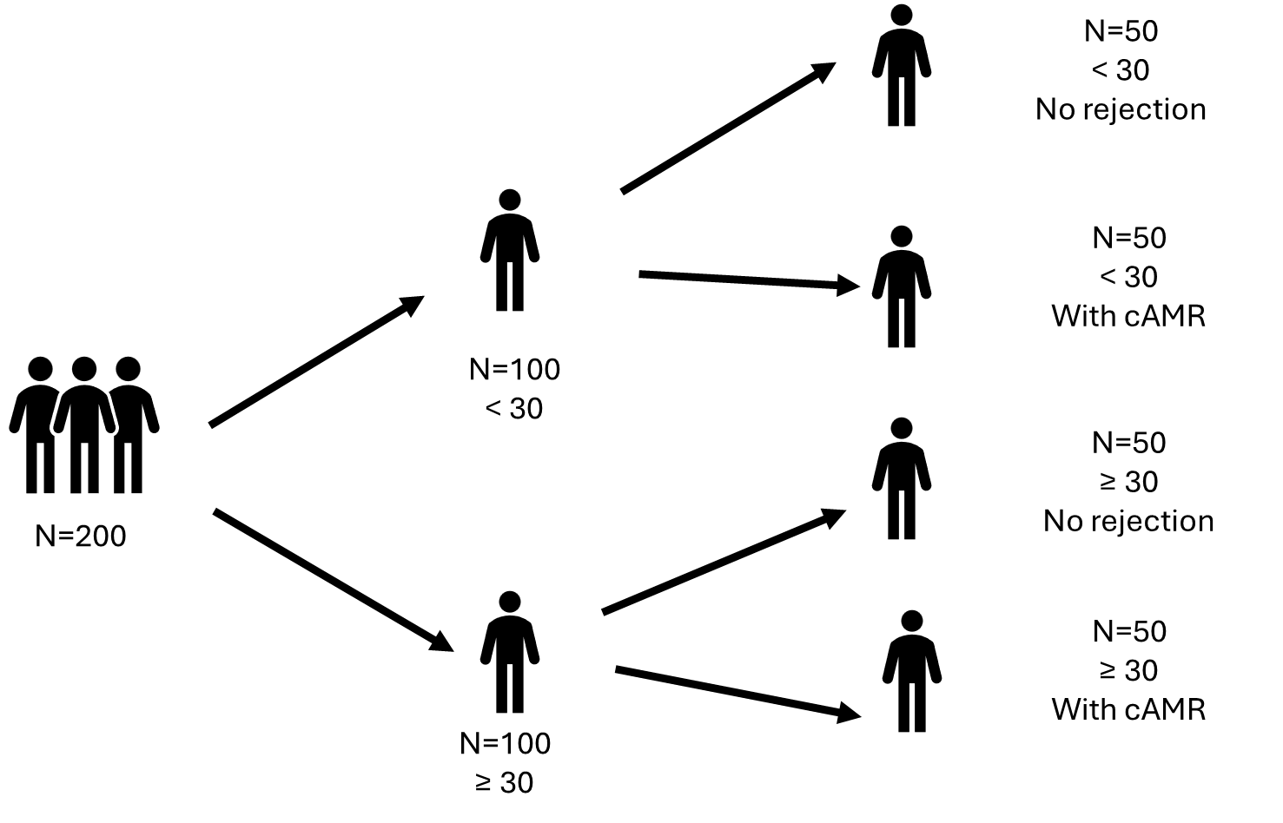
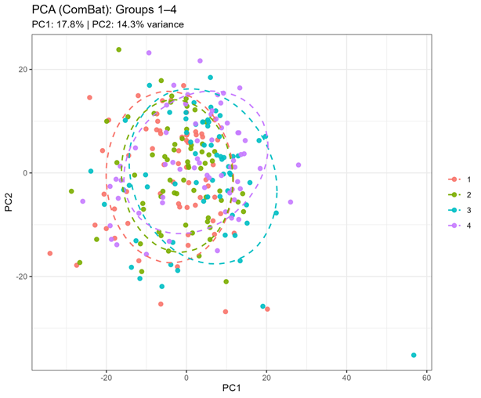
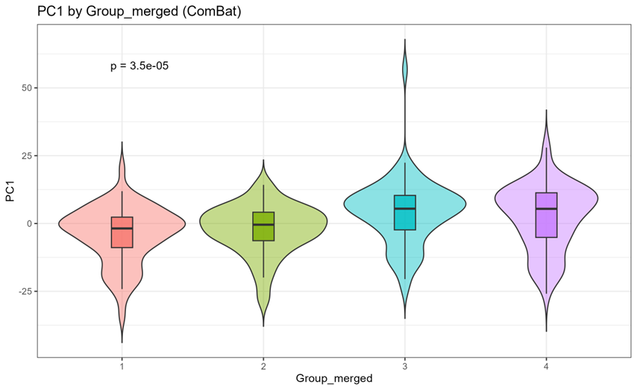
Why do kidney transplants fail so early in young people?
Dr Michael Corr, Dr Jane English, Professor Matt Griffin, Professor Peter Maxwell, Dr Gareth McKay
Background
The best treatment for kidney failure remains kidney transplantation. Unfortunately, younger people seem to be at increased risk of losing their transplant early. I want to understand why this happens, so in the future we can prevent it.
Methods:
Results:
Serum analysed for ~800 proteins
Able to differentiate between rejection/non-rejection, and demonstrate subtle proteomic difference in recipients of different ages
Conclusion: Our early analysis has allowed us to demonstrate unique protein signatures between transplant recipients with chronic rejection and those with healthy grafts. We also see differences in immune based proteins in younger recipients compared to older recipients. This would suggest differences in their immune systems- we are doing more work currently to better understand these differences.

Slide 9







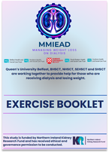




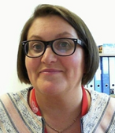


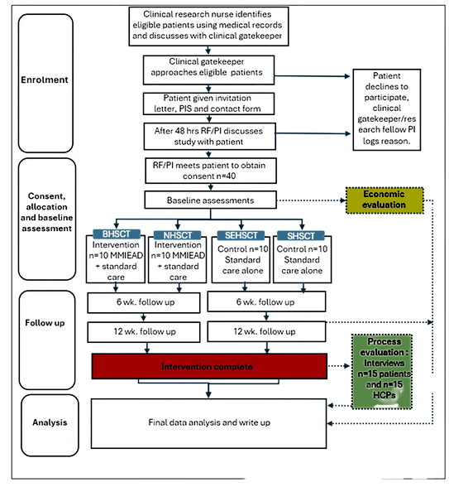
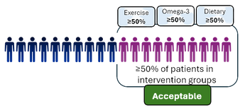
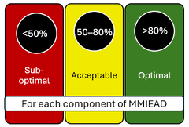












Multi-Modal Integrated intervention combining Exercise, Anti-inflammatory & Dietary counselling (MMIEAD) for kidney cachexia: a mixed-methods feasibility cluster randomised controlled trial and process evaluation
MMIEAD has been kindly funded by Northern Ireland Kidney Research Fund
BACKGROUND
Aligned with implementation science guidance, we generated evidence to understand the aetiology and burden of kidney cachexia, the effectiveness of related interventions; and developed a theoretical model of components and mechanisms of action for a Multi-Modal, Integrated, Exercise, Anti-inflammatory and Dietary advice (MMIEAD) intervention for kidney cachexia to enhance intervention-context alignment.
Objectives:
- Determine patient eligibility and recruitment rates;
- Identify intervention retention and adherence rates;
- Determine considerations for optimal study design and data collection burden;
Design: Incorporates implementation science frameworks (PRISM/RE-AIM) and has three phases. Phase 1: deliver and evaluate a 12-week multimodal intervention using a feasibility cRCT design. Phase 2: conduct a process evaluation with study participants and health care professionals (HCPs). Phase 3: assess the feasibility of conducting a definitive economic evaluation.
Participants: Patients - CKD Stage 5 in receipt of haemodialysis for >3 months, have oedema-free weight loss of at least 5% in 12 months or Body mass index (BMI) less than 20 kg/m2, aged >18 years. HCPs - member of the multidisciplinary healthcare team for more than three months and have exposure to the study.
Randomisation: Two sites (BHSCT/NHSCT) intervention group, two (SEHSCT/SHSCT) control group.
Sample: Phase 1 and 3: 10 research participants per intervention site; 10 research participants per control site; 40 in total across all sites (n=4). Phase 2: 15 patients for interviews and 15 HCPs for interviews or focus groups across all sites.
Trial registration number: NCT07107087 https://clinicaltrials.gov/study/NCT07107087
Prof Joanne Reid
Dr Carolyn Blair
METHODS
RESEARCH AND GOVERNANCE
Integrated Research Application (IRAS) approval and Study Wide Governance (SWG) approval received
Capacity and capability and workplace agreements received from NHSCT and SEHSCT
Opening for recruitment in NHSCT and SEHSCT – September 25
FORTHCOMING PUBLICATIONS
The anti-inflammatory effects and safety profile of omega-3 fatty acids in patients receiving haemodialysis, in relation to dose, EPA/DHA content, ratio and source: a systematic review and meta-analysis - submitted Clinical Nutrition 22.08.25
MMIEAD protocol/implementation science manuscript - review with team 03.09.25
Co-designing the implementation process of an exercise intervention as part of a multimodal intervention for patients with renal cachexia - review date 17.10.25
PROGRESSION CRITERIA
CONFERENCES
Invited conference presentation and panel discussion 18th SCWD conference, 11-13.12.25 in Rome “impact of cachexia on patients and caregivers” https://society-scwd.Org/annual-conference/programme/ - Prof. Joanne Reid
Three conference abstracts submitted SCWD Conference - Dr Carolyn Blair
Progression to a definitive RCT will be determined by:
Recruitment rates and acceptability of the intervention
Compliance with the multimodal intervention - assessed according to individual components (e.g., number of exercise sessions/ tablet count).
Our collaborators

Slide 10




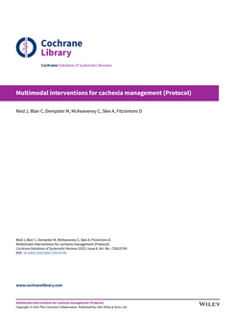
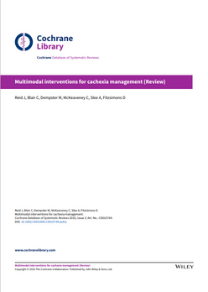











Reid J, Blair C, Dempster M, McKeaveney C, Slee A, Fitzsimons D.
Multimodal interventions for cachexia management.
Cochrane Database of Systematic Reviews 2025,
Issue 3. Art. No.: CD015749. DOI: 10.1002/14651858.CD015749.pub2.
This work has been kindly funded by NIKRF and HSC R&D Division PHA
Prof Joanne Reid
Dr Carolyn Blair
WHAT ARE COCHRANE REVIEWS?
Cochrane Reviews are highly rigorous systematic
reviews of primary research in health care and
policy and are recognised as the gold-standard of research evidence. The main purpose of a Cochrane review is to:
Identify research gaps
Stimulate debate and new evidence
Provide evidence of quality and identify limitations
Inform healthcare policy and clinical guidelines
WHAT HAS THIS REVIEW ACHIEVED?
1. Comprehensive, global evidence synthesis
We provided the most up-to-date, systematic
evaluation of multimodal interventions for cachexia
across chronic conditions, providing a reference
point for clinicians, researchers, and policymakers.
2. Clear identification of knowledge gaps
We highlighted precisely where evidence is lacking
guiding researchers and funding bodies toward
priority areas for future studies.
3. Establishes a benchmark for future research
We set a methodological gold standard for how
future trials should be designed, reported, and
measured to ensure reliability and comparability.
4. Promotes research quality and transparency
We called for better trial design, including
larger sample sizes, standardised interventions,
longer follow-up, and consistent reporting.
5. Informs guideline developers and policymakers
We provided highly credible, independent evidence
that helps organisations like NICE, ASCO and ESMO
create or update cachexia management guidelines.
6. Promotes the importance of a patient-centred focus
We emphasised aligning research with what matters
most to patients and caregivers using outcomes
such as physical function, fatigue, and quality of life.
WHAT ARE THE OUTPUTS?
PROTOCOL
REVIEW
WHAT IS THIS REVIEW ABOUT?
Cachexia is a debilitating condition linked to
chronic illnesses, marked by unintentional
weight and muscle loss, fatigue, and reduced
quality of life. Multimodal interventions combining nutrition, pharmacology, and exercise aim to address its complex causes. This Cochrane review evaluated the safety and effectiveness of multimodal interventions for cachexia management.
562 full text views (direct from Cochrane database)
Cited by 5 unique high quality international publications
Has informed the design and development of our multimodal intervention for kidney cachexia
Presented at WG 5: Global Policy & Advocacy meeting and nationally (UCL)
Abstract submitted to present at 18th SCWD Conference, Rome, 11-13.12.25
WHAT DID WE DO?
We searched CENTRAL, MEDLINE, Embase,
PsycINFO, and two trials registries in July 2024.
We reviewed the evidence from nine randomised controlled trials involving 926 adults with cachexia or at risk of it. Studies compared multimodal interventions with treatment as usual, a variation of the intervention, or unimodal approaches. Primary outcomes were physical function, strength, and adverse events. Secondary outcomes included body composition, weight, quality of life, appetite, fatigue, and biochemical markers. A meta-analysis was conducted using Revman and certainty of evidence was rated using GRADE.
To access the full review please scan the QR code or use DOI: 10.1002/14651858.CD015749.pub2.

Slide 11




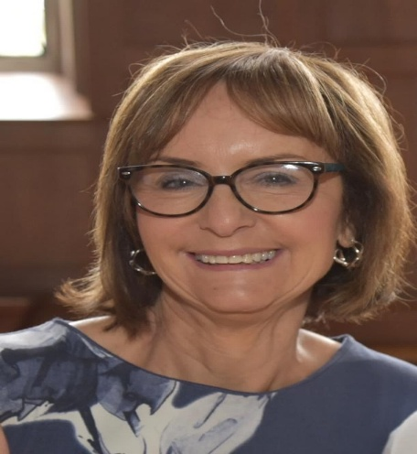
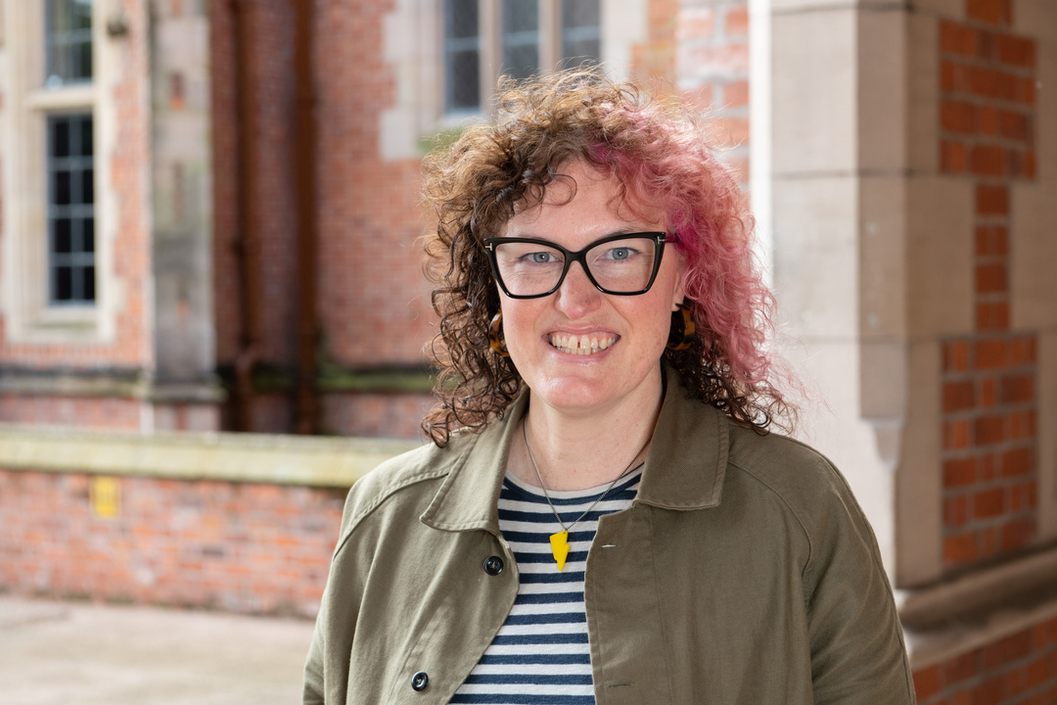




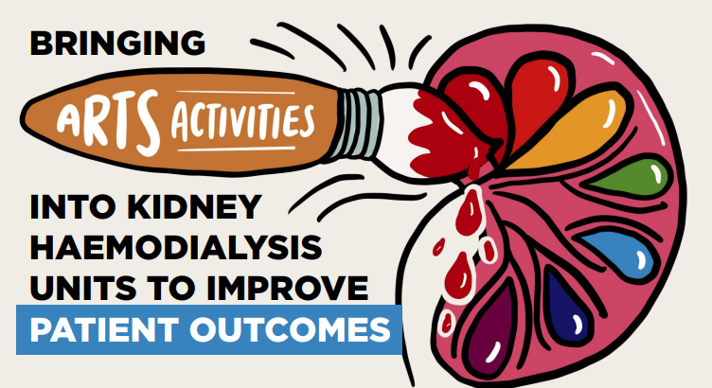
Prof Helen Noble & Dr Trisha Forbes
School of Nursing and Midwifery,
Queen’s University Belfast
trisha.forbes@qub.ac.uk
Helen.noble@qub.ac.uk
Objectives
Identify current provision of arts activities available for individuals with CKD internationally
Explore the experiences of renal healthcare staff and arts coordinators who provide activities in renal units
Identify recommendations for policy and practice and co-design a manifesto brief
Methods
Multimethod approach
Online survey (Jan - Nov 2023)
Qualitative, semi-structured interviews
Healthcare staff in renal centres/arts organisations
Conclusion:
Encouraging outcomes in terms of arts in healthcare.
Practitioners who adopted arts activities observed benefits of this person-centred approach in action, predominantly in terms of the positive impact on the wellbeing of individuals with kidney disease and improved relationships with staff in dialysis units.
Further attention and funding should be focused on arts activities within renal centres.
Qualitative themes and subthemes
(1) Positive outcomes for patients:
Reduced boredom & constructive use of time
Patient legacies
(2) Staff engagement and enthusiasm
Staff observing positive outcomes for patients
Staff participation in the activities
Relationship development between staff and patients
(3) Barriers to participation
Resources – funding and staffing
Infection control/logistics/patient fatigue
LMIC ‘surviving rather than thriving’
Results
119 survey respondents from 29 countries & 16 interviewees
39 survey respondents (33%) indicated that arts activities are/had been available to patients in their units.
Types of arts activities included visual art activities, music, literature/creative writing, film, movement/dance and craft.
Final stages:
We co-designed and created the policy brief with Nifty Fox Creative, which was launched on 17th January 2025.
The findings of the PAINT study were published in the journal Nephron in May 2025:
Forbes, T., Wilson, A., McKeaveney, C., Carswell, C., Bailey, C., Baxley Lee, J., Laico, M., Meaney, C., & Noble, H. (2025). A multimethod international mapping exercise of arts interventions in renal units: the PAINT project. Nephron, 149(5), 288–301. https://doi.org/10.1159/000542878
Trisha delivered an oral presentation on the PAINT Project at the European Dialysis and Transplantation Nursing Association Conference in September 2025 in Athens, with thanks to the Dr Jennifer McCaughan bursary from NIKRF.

Slide 12

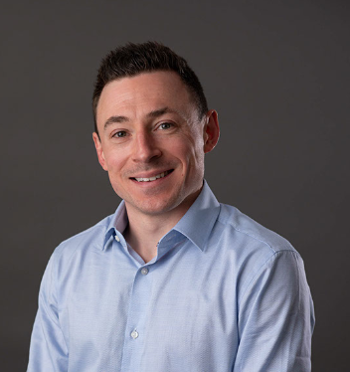
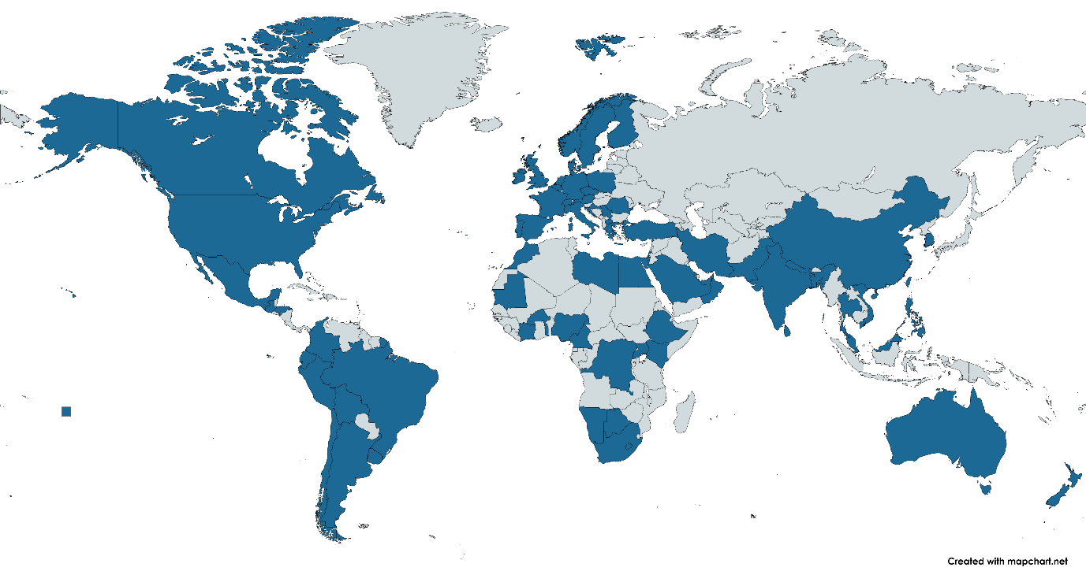











Individual traits contribute to variations in international kidney biopsy practice
Introduction
Methods
Results
Findings
Dr Michael Toal
1181 nephrologists
83 countries
When should nephrologists recommend a kidney biopsy?
Electronic Questionnaire
Increased propensity
Elevated proteinuria
Males
Younger age
Frequent operators
Normal kidney volume
CONCLUSION: Significant variation in practice patterns within countries and across the world.

Slide 13
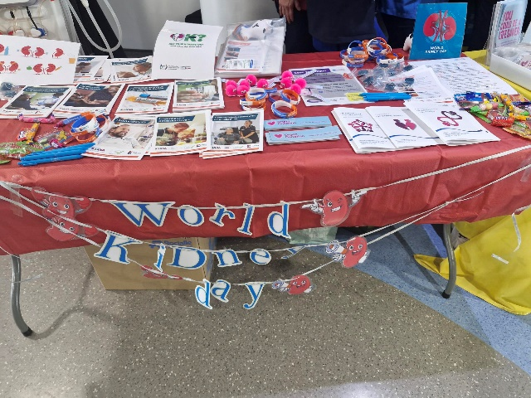


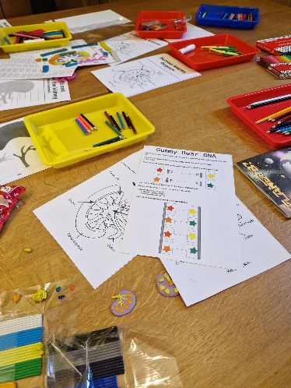
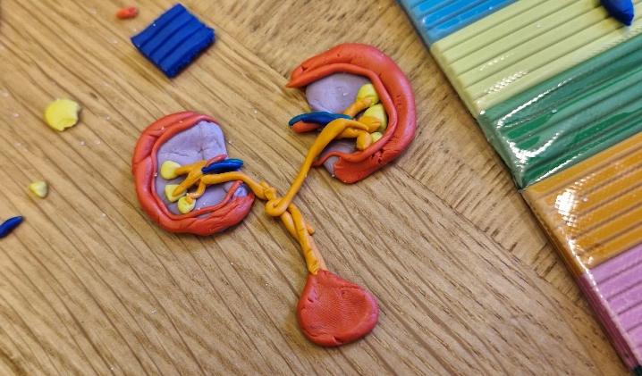






Dr Claire Hill – NIKRF Senior Research Fellow
January – April 2025
Claire virtually attended the Telomeres & Telomerase Conference (Cold Spring Harbour) in February 2025.
Claire learnt about cutting edge research in the field of telomere biology, and how telomere shortening impacts aging and health.
Telomeres are protective caps at our chromosome ends to protect important DNA.
Claire will use this knowledge to guide her future exploration of telomeres in the context of kidney disease.
NIKRF funding during this time contributed towards work now presented in a manuscript ready for submission:
“Accelerated epigenetic ageing in diabetic kidney disease: A comparison of ten epigenetic clock measures in type 1 diabetes.”
This was a collaboration between QUB (led by Prof AJ McKnight, Dr Gareth McKay and Prof Peter Maxwell) and FinnDiane in Finland.
This work shows accelerated biological ageing in diabetic kidney disease and supports development of epigenetic clinical biomarkers to help predict onset and progression.
This work was presented at a kidney disease conference in May where Claire received a Best Communication Prize (EDNSG).
Claire enjoyed hosting and contributing to public engagement events, such as World Kidney Day in Belfast City Hospital and NI Science Festival at QUB.
In May 2025, Claire began a 5-year Vivensa Foundation Proleptic Fellowship:
“Exploring novel biomarkers: Unveiling sex-inequalities in ageing and age-related diseases”
- with kidney disease as her primary focus.
Claire thanks NIKRF for all the support and guidance she has received to advance her research and personal development.

