Slide 1


Nephrology & Transplantation Report
NIKRF AGM
16.09.26

Slide 2
Introduction
Staffing and workforce overview
Rotas and working patterns
Funded lead positions
Patient safety and clinical governance
Activity
Outcomes
Collaborations
Summary
Case presentation
Questions

Slide 3
Staffing overview
41 Medical Renal Staff Members
19 Consultant* and SAS (Specialty, Associate Specialist and Specialist) Staff
1 Consultant Psychologist
3 SAS (1 SAS Surgeon and 2 SAS Nephrologists)
4 Consultant Surgeons
  1 Consultant on employment break
  ST8 Transplant Surgeon (final year of training)
  ST7 Transplant Surgeon (penultimate training year, doing a year of training in Manchester)
  ST6 Vascular Surgeon (will always have at least an early stage Vascular Surgeons in future)
11 Consultant Nephrologists
  1 Transplantation (Nephrology clinic, on employment break)
  4 Nephrology & Transplantation
  4 Nephrology (no Transplantation)
  1 Nephrology (Transplant Clinic)
  1 Locum
Resident Doctors in Nephrology
  13 at Registrar Tier Level
  5 F2/IMT/GPST Tier Level
  4 FY1
* 2 Consultants on employment break

Slide 4
Workforce overview
Challenges
  Epic (electronic care record) introduced 2024
    Initial resistance to use and lack of engagement
    Now being utilized much more effectively
  Consultant absences
    Early alert issued in October 2025
    3 Nephrologists and 1 Surgeon off at the same time on either sick leave or compassionate leave
  Consultants that have left the service
    Consultant Nephrologist 2024 (worked on living donor programme)
    Consultant Anaesthetist 2025
    Consultant Nephrologist and Consultant Surgeon (on employment break)
  Megan Joffe (Clinical Psychologist) led Renal Workshops 2024/25
  Listening exercise with Resident Doctors 2025
  McBride/Hill Report 2025
  NHSBT External Case Review 2026

Slide 5
Workforce overview
Responses
  Epic Builder and Power Users
  Slow adopters to now pilot specialty for morbidity discussions on Epic
  Departmental Away Day September 2025 (not fully attended)
    Complex General Nephrology MDM
    Explored GLP1 agonist funding for patients listed but suspended due to excess weight
    Also explored increasing outpatient capacity
  Civility and respect training offered (variable uptake)
  Departmental code of conduct
  Updated all governance and patient safety arrangements
NHSBT positive feedback
  Greater emphasis on multidisciplinary working
  Improved communication and collaboration
  Stronger engagement with external partners
  Significant progress made in strengthening general governance arrangements
    Including MDM and Morbidity & Mortality discussions
    Incident reporting with a greater focus on learning and continuous improvement

Slide 6
Workforce overview
Positives
  A Consultant Nephrologist post advertised and interviews on 8th of October 2026
  Academic Nephrologist Post being advertised (Joint QUB iREACH/Trust appointment) in late 2026
  Anaesthetic support, with access to a specialist pre-assessment clinic and multidisciplinary case discussions
  There is a Consultant Clinical Scientist who is the Clinical Lead of the Regional H&I Laboratory
  A fully staffed nursing team including 4 x living donor and 3 x recipient coordinators
  There is 24/7 access to theatre including 10 elective operating sessions per week
  A dedicated and recently renovated Renal Theatre
  Supportive Service Management and Divisional Teams
  New Band 7 Governance Post for Nephrology and Transplantation

Slide 7
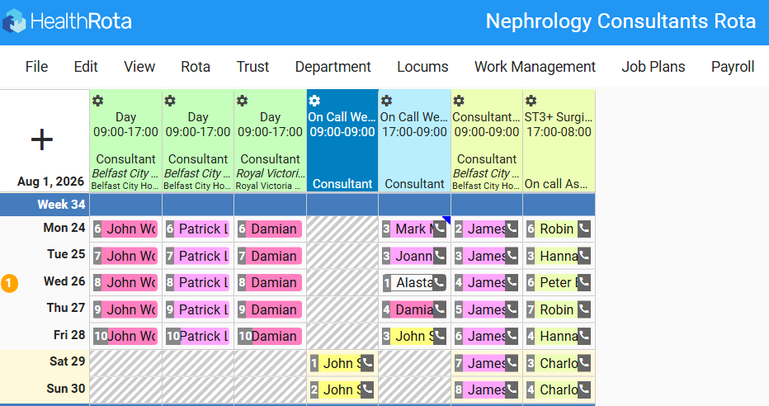
Rotas and working patterns
Dedicated web-based platform
Health Rota
  Increase in forward scheduling
  Equity and better visibility
  Now includes Surgeons & ST3+ Surgical Assistant (since July 2026)
Weekday Daytime
  Inpatient Nephrologists x 3
    Transplant Ward in BCH
    General Nephrology Ward in BCH
    Consult service (inc. RVH)
  Consultant Surgeon (on call and elective work)
    Daily ward round with Transplant Ward Nephrologist
Weekend and Out of hours
  On call Nephrologist
  On call Surgeon
  Surgical Assistant
People off inpatient duty or on call
  Dialysis Unit
  Outpatient clinics
  Theatre lists
  Meetings
  Admin, teaching, training, CPD, external roles (NIMDTA, QUB), research etc. etc. etc.
  Annual leave (and work-life balance!)

Slide 8
Funded Lead Positions
Nephrology Leads
Surgical Leads
Fogarty, Damian - Etriage
Woods, Jd – Consultant Nephrologist Rota
Courtney, Aisling – Transplantation QI*
Borthwick, Emma – PSCG Nephrology
Hanko, Jennifer – Nephrology QI
Shields, Joanne - LCC
Finn, Mairead - PD
Aung, MyintZu – Resident Doctor Rota
McClure, Mark - Vasculitis
McDaid, James – HTA
McGrogan, Damian – Theatre and Vascular Access
Brown, Tim – Nephron Sparing Surgery^ and Organ Utilisation Lead**
Magowan, Hannah – PSCG Transplantation***
* On employment break, EOI being released in October (post-Consultant appointment)
^ Auto-transplantation programme closed
** On employment break, EOI being released in October (post-Consultant appointment)
*** Recently left post in May 2026, EOI being released in October (post-Consultant appointment)

Slide 9
Patient Safety & Clinical Governance
Datix/SAE/SAI/NHSBT incident reporting
  Under reporting previously highlighted in two previous HTA Audits
  Now got routine reporting of all unplanned returns to theatre <30 days
  Action plans from any SAIs complete or in progress
    Shared learning letters
    Updated Recipient information (based on NHSBT POL 191/5)
Twice monthly recipient MDM and monthly live donor MDM
  Now got referral template with SmartPhrase
  Real time documentation on Epic
  Unit policy that MDM decisions are final
  Rotation of Chair if Chair is presenting a case for listing

Slide 10
Patient Safety & Clinical Governance
Transplant follow up and Consultant Regional/Paediatric advice MDM
  Starting in October
  3rd Thursday of month from November
HLA Antibody Delisting MDM
  1st Monday of month
  H&I Scientist
  Surgeon
  Nephrologist
Monthly organ utilisation meetings
  Terms of reference
  Attendance records
  Minutes (including activation date on deceased donor waiting list)
Monthly Mortality and Morbidity Meetings (chaired by PSCG Leads)
  Further monthly Specialty Mortality Review and Patient Safety Meeting for shared learning
  Mortality pathway live on Epic for all Teams
  Renal is NI pilot specialty for morbidity discussion on Epic with prompts
    Duty of candour
    Local incident reporting
    NHSBT incident reporting
    Shared learning across Renal
    Sharing learning with other teams

Slide 11
Nephrology updates
New Low Clearance Clinic Specialist Nurse
Hepatitis B Vaccination Programme
Complex General Nephrology MDM
Vasculitis MDM
Vascular Access MDT
Complex Vascular Access Procedures (e.g., SuperHeRO graft planned)
Increase in PD
  Laparoscopic/Percutaneous insertions and extended length catheters for high BMI
Nocturnal Dialysis
New drugs for IgA Nephropathy
Trials

Slide 12
Nephrology Trials
IMPEDE-PKD
  Repurposing metformin to slow cyst growth in PKD
Currently recruiting for EASi KIDNEY
  Aldosterone synthase inhibitor
  Have already recruited above our target number
Trials that will run or could run via iREACH:
  TRAP (targeted removal of aberrant protein) to selectively remove abnormal IgA
  A new potential therapy for chronic AMR
  A trial of a small molecule which may correct protein folding in PKD1 variants
Ongoing recruitment to rare disease registries e.g. UKIVAS

Slide 13
Transplant Activity
NHSBT records activity by FINANCIAL/TAX year (April 1 – March 31)
A report is produced every year and published in September
  Waiting list size
  Transplant numbers
  Response to offers
  Outcomes etc.
Allows for comparison with previous years and other centres
Full report and previous reports are freely available!
Please refer to the reports and speak to us before contacting the Chief Executive for data
  https://www.odt.nhs.uk/statistics-and-reports/organ-specific-reports/
A key piece of data requires attention from Renal stakeholder groups
  Consent rates for organ donation were 69% in 2020/21
  Now consent rates only 57% in 2025/26

Slide 14
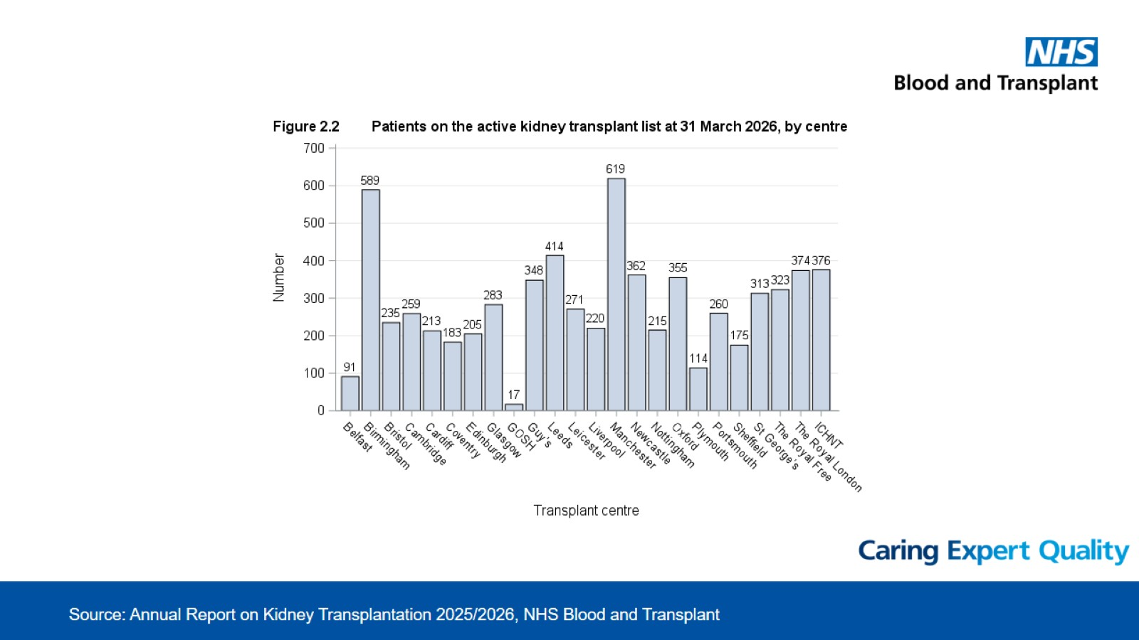
90 patients in 2024/2025
(Number fluctuates with suspensions e.g., illness, holidays etc)

Slide 15
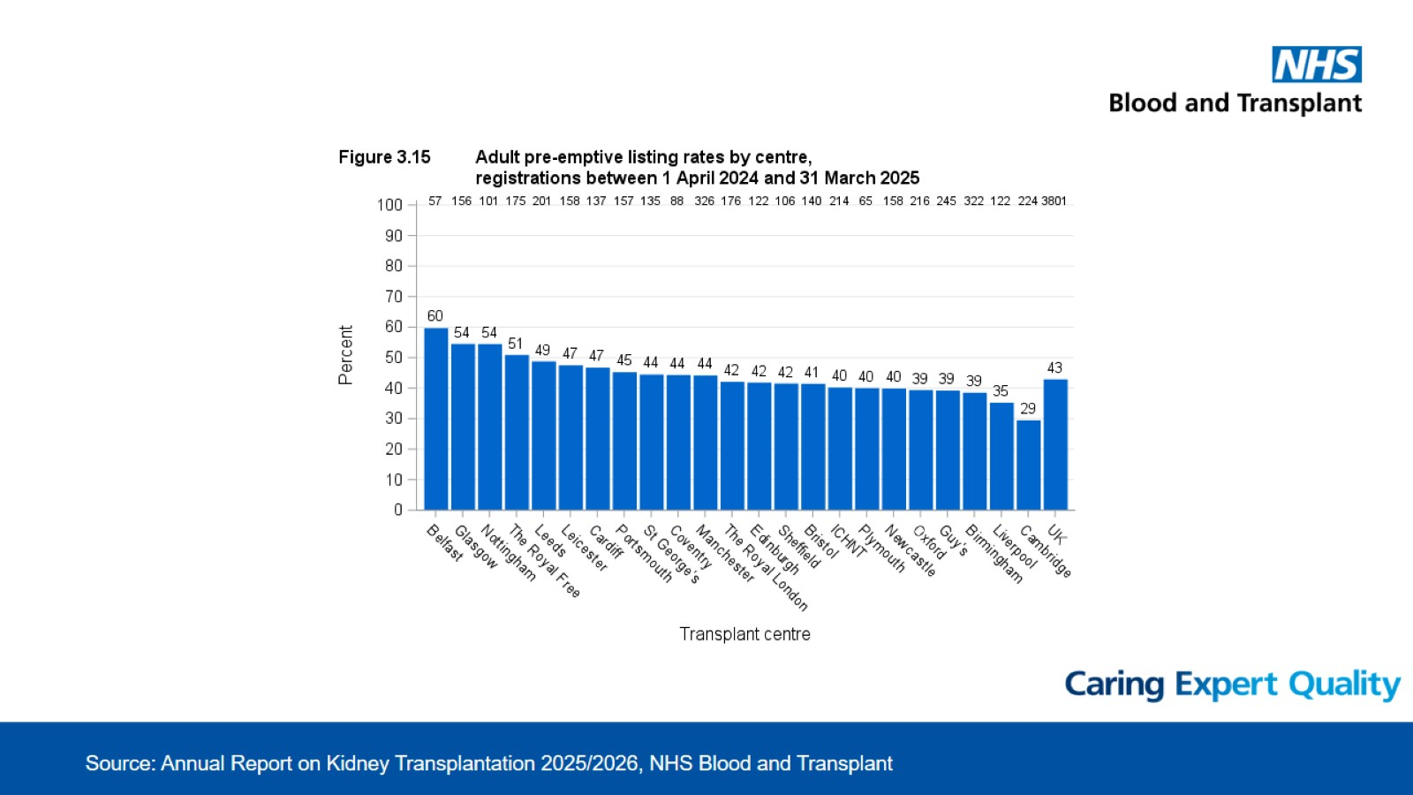
Reflects excellent practice in referring centres

Slide 16
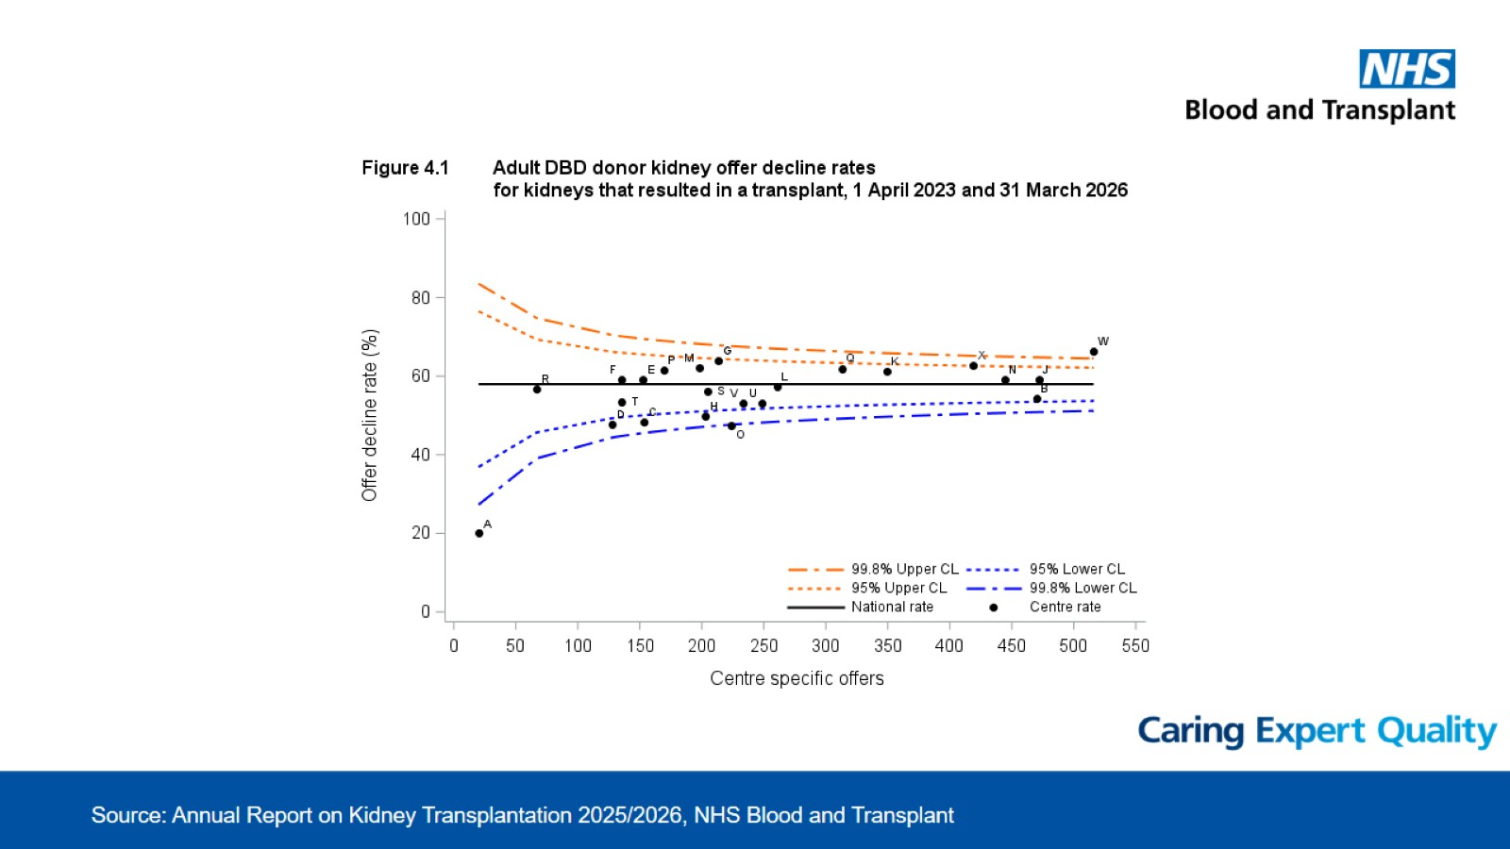
Belfast is Centre A – Least offers and lowest decline rate

Slide 17
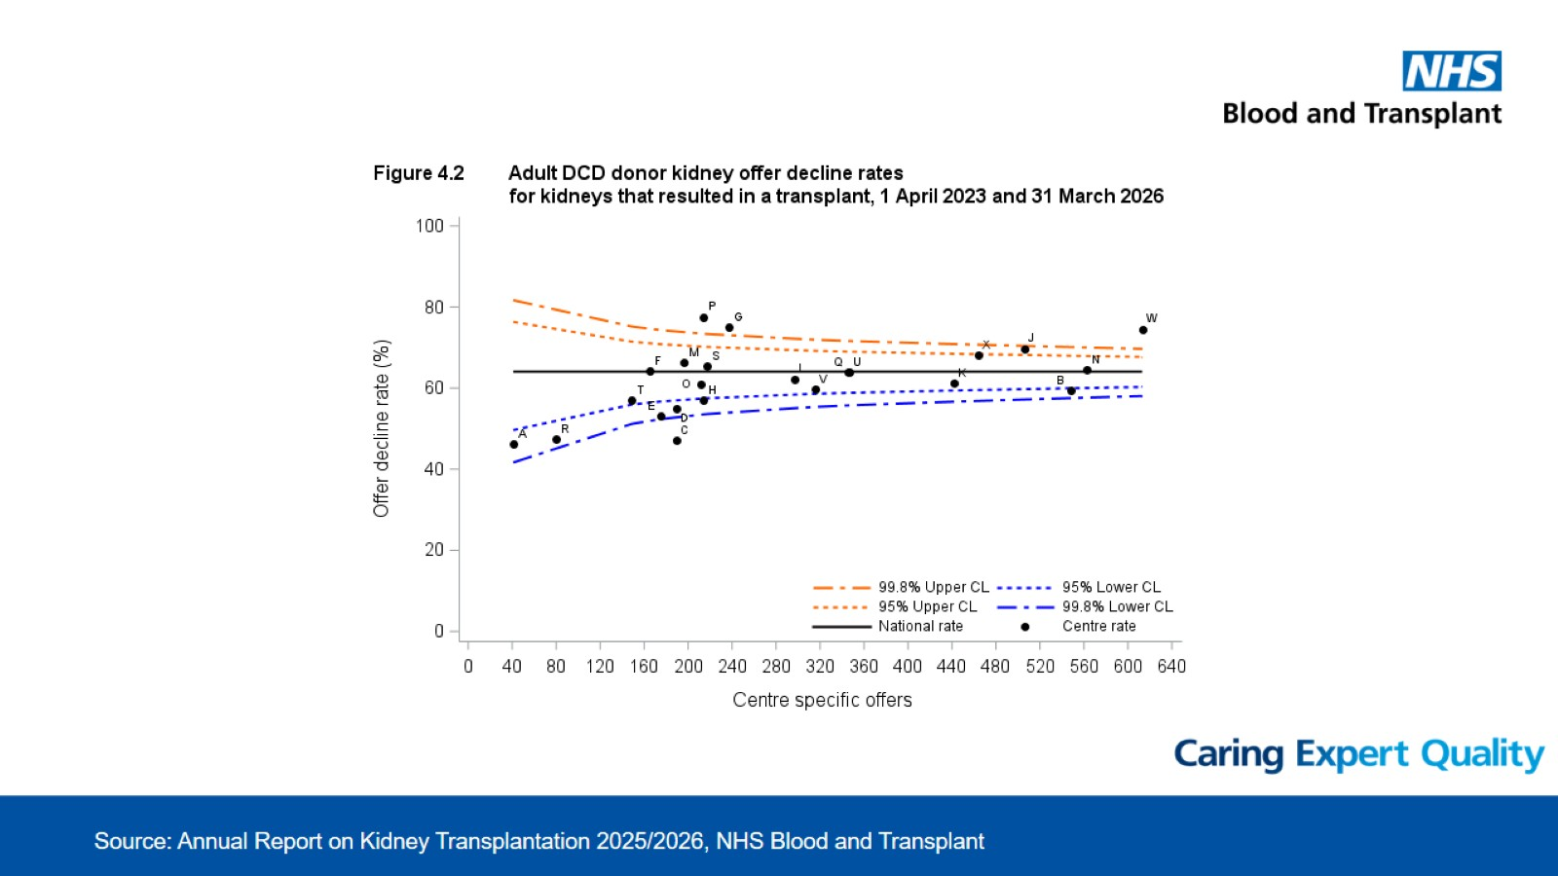
Belfast is Centre A – Least offers and joint lowest decline rate

Slide 18
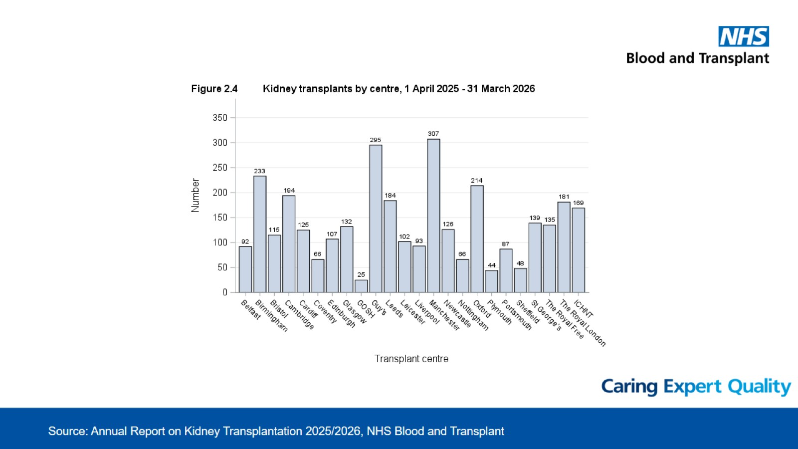
90 transplants in 2024/2025

Slide 19
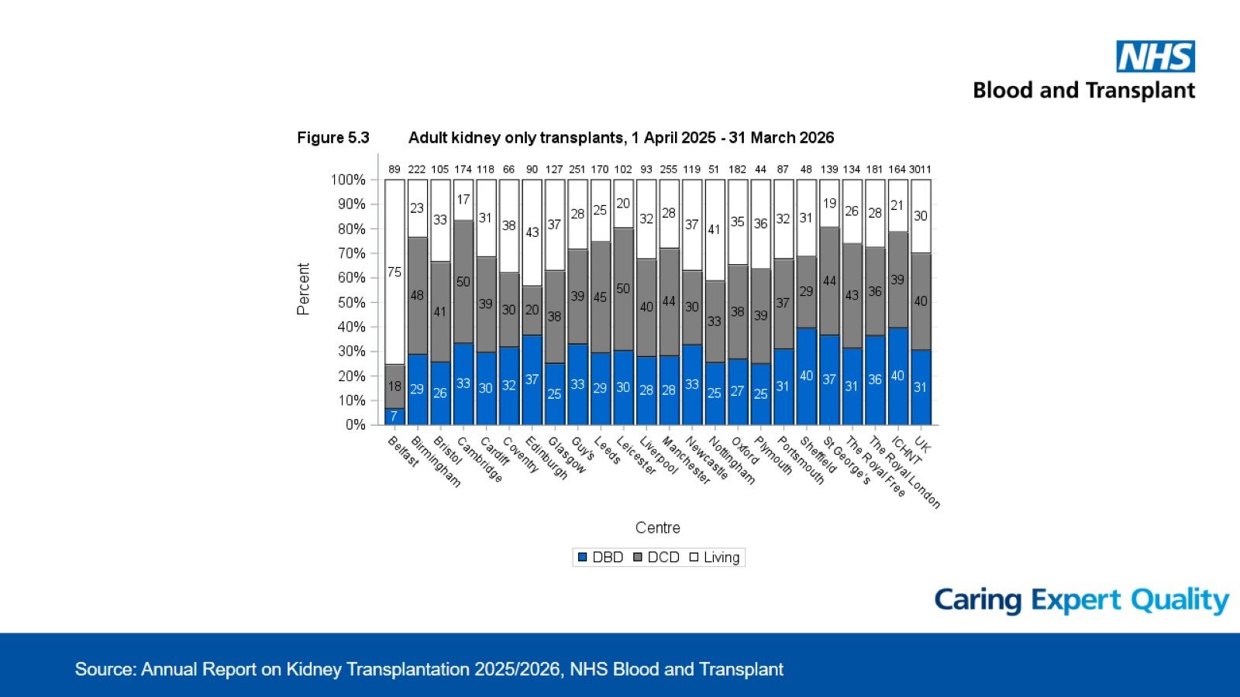
Belfast has highest proportion of living donor kidney transplant in UK

Slide 20
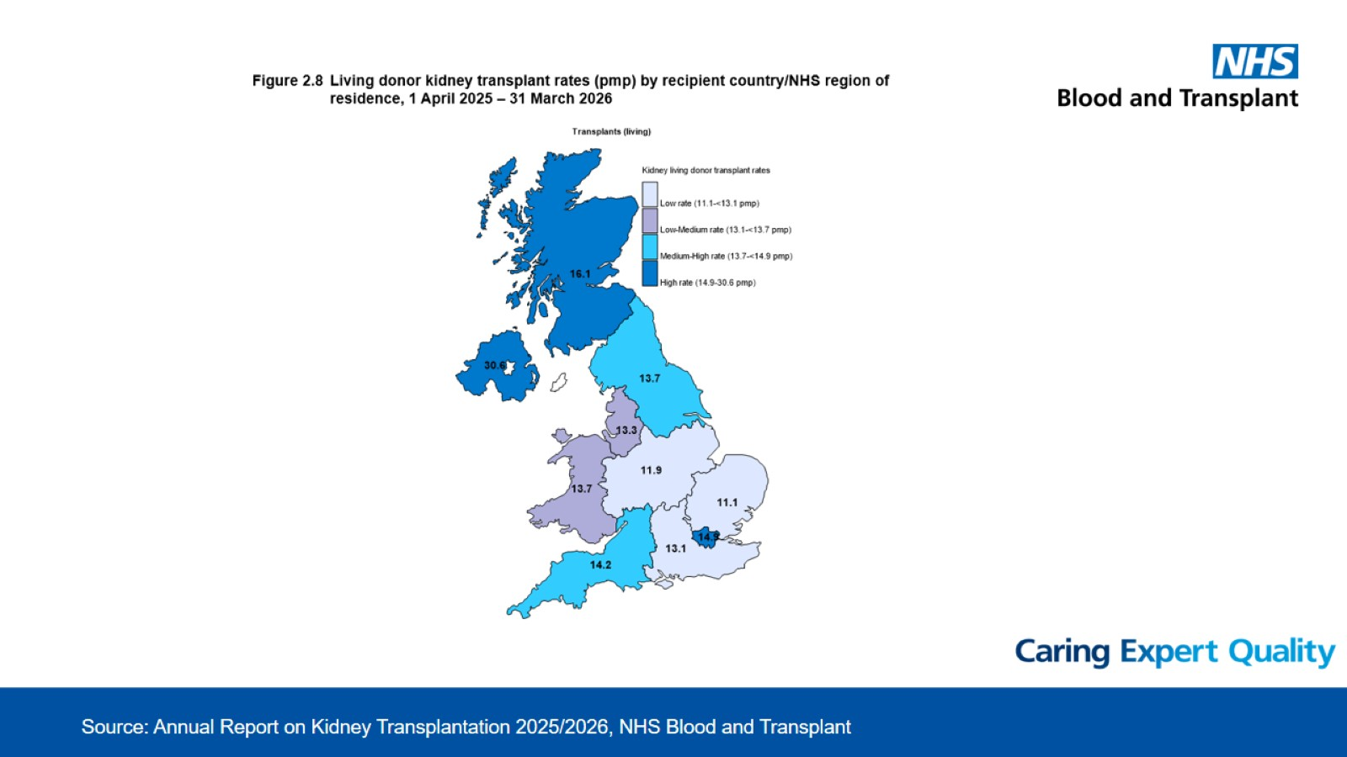
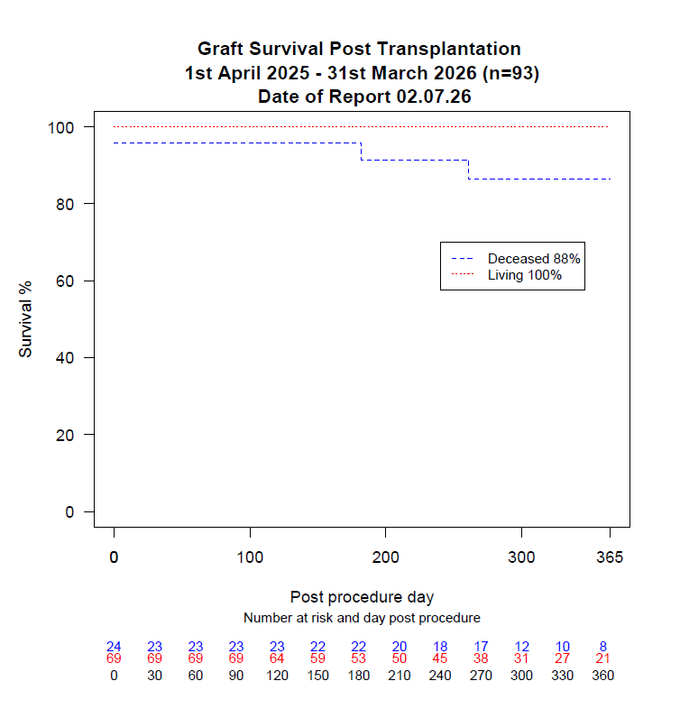
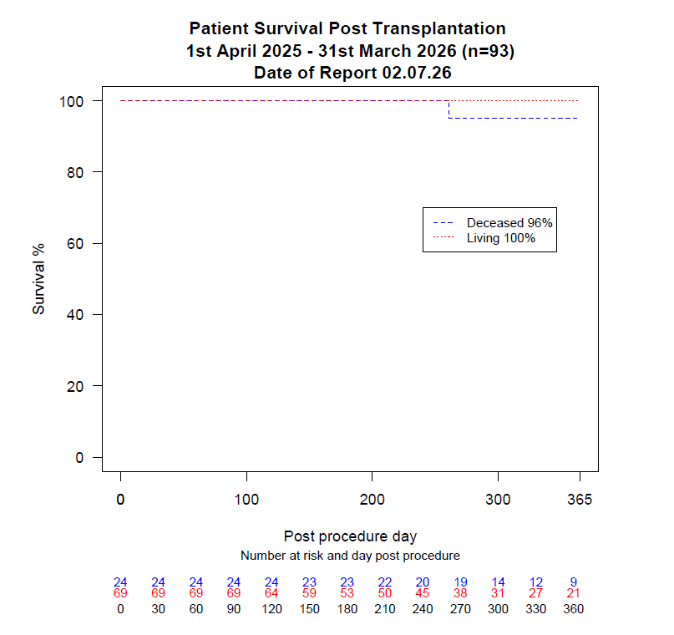
Outcomes
NI has highest number of living donor kidney transplant per population in UK

Slide 21
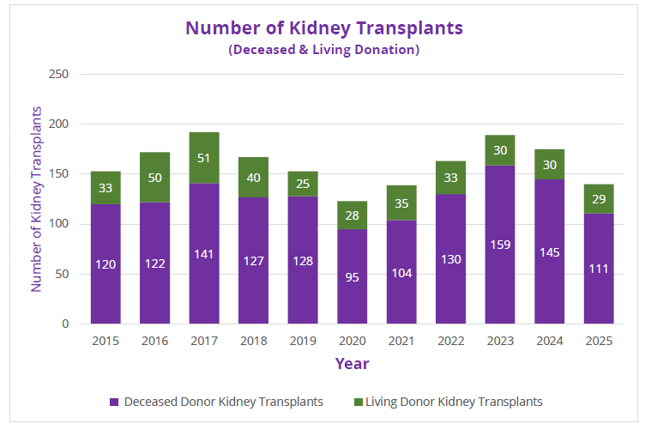
Republic of Ireland

Slide 22
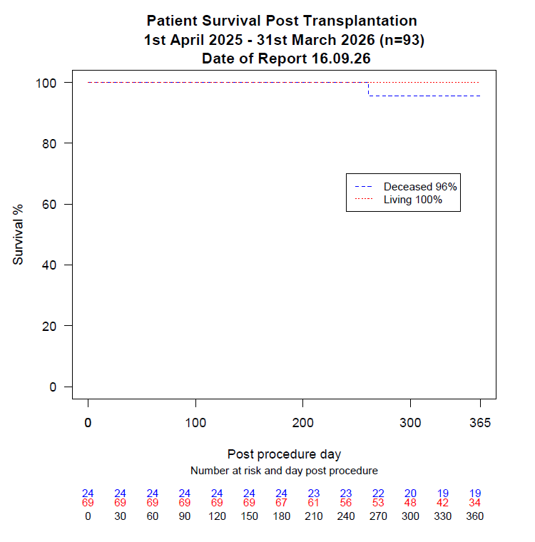
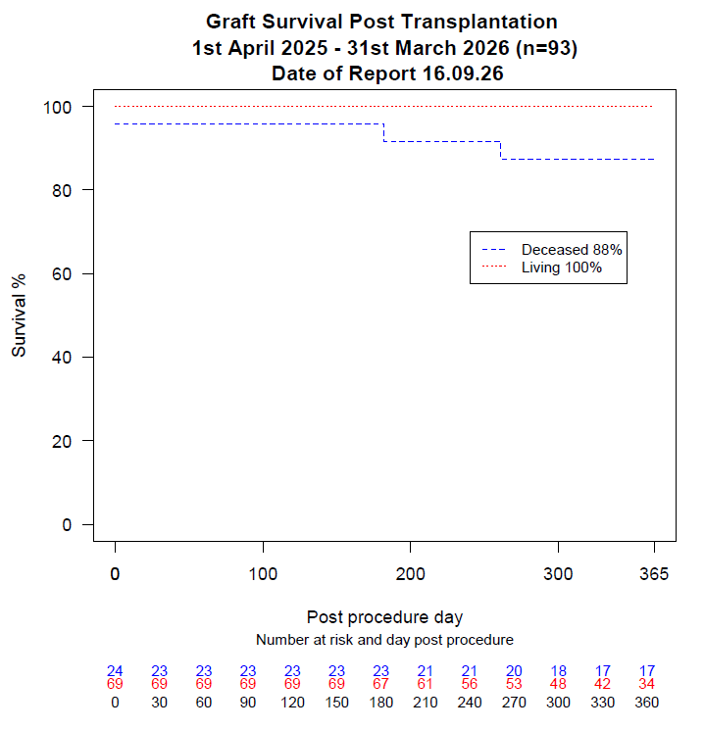
Outcomes
Includes n=1 simultaneous kidney-pancreas transplant
Two earliest graft losses were fast track kidney offers

Slide 23
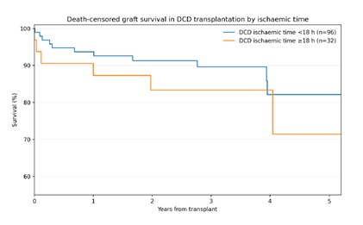
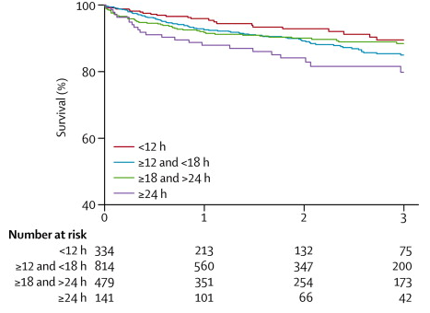
Cold ischaemic time
Belfast Data 2021-2025
Seminal Paper by Summers et al., Lancet 2013
  94% of DCD kidneys with extended CIT were fast tracks (FT)
  14/37 (38%) pre-emptive 1st-time recipients with FT had graft loss < 1 year (n=2) or GFR <25
Cold ischaemic time (CIT) is important for DCD kidneys

Slide 24

Organ offers
A new approach to fast tracks piloted from September 2026
  Aim to minimise cold ischaemic times
To make a shared decision with your Surgeon the following information about the donor should be discussed with you:
  Age range (by decade)
  Gender
  Cause of death (such as trauma or stroke)
  The type of donor (donation after brain death or donation after circulatory death)
  Whether the cold ischemia time (time out of the body) will be long (>18 hours)
  Whether the donor poses a greater risk of transmission of infection or cancer
  Whether the donor organ has a particular risk of failing or having poor function
  If the kidney is damaged or has been declined by all other UK transplant centres

Slide 25
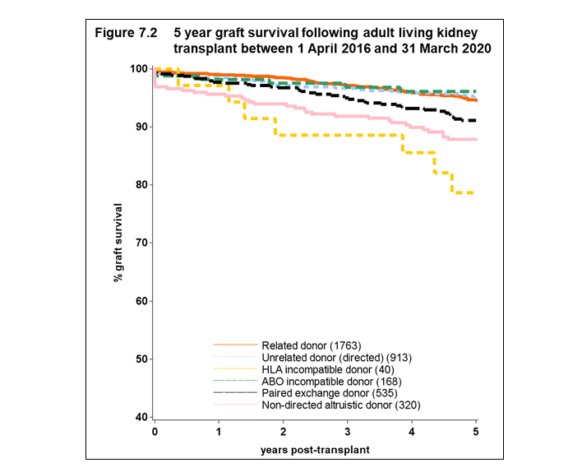
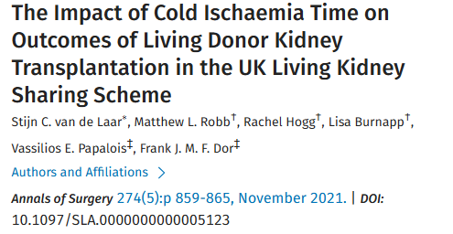
Live Donor Kidney Transplant
Reviewed UK outcome data
Transplant Team Discussions during August
  Full MDT involvement
  Strategy and plan for kidney sharing scheme
  Established protocol for ABOi kidney transplants
Further Consultant involvement in programme
  Consultant Nephrologists (3 in total)
  H&I Scientist
Surgical changes
  Newly refurbished theatre
  Reducing Cold Ischaemic Time (CIT) by increasing efficiency
  Performed first two <3.5 hour CIT transplant since Epic Go Live

Slide 26
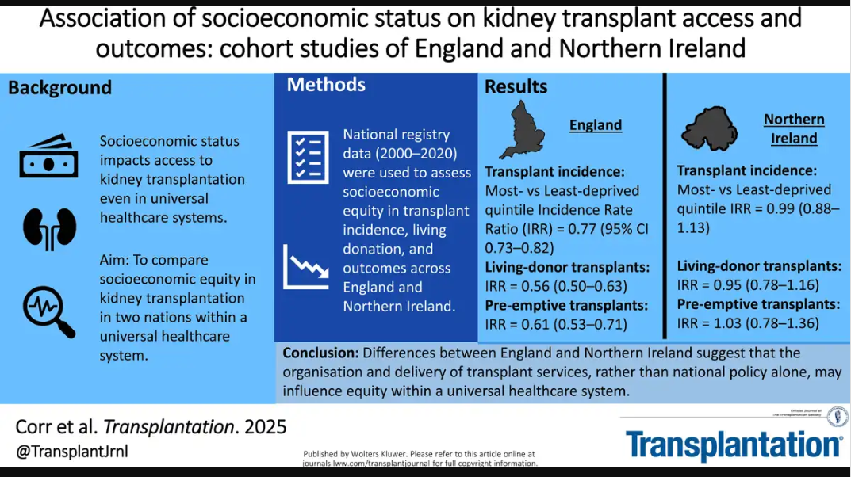
Collaborations
Collaboration with Guys for ABOi transplant protocol
  Dr McClure (Belfast)
  Dr Game (Guys)
Scottish Renal Collaborative
  Meeting monthly
    Most recent on 26/8/26
  Mutual Aid agreement for Paediatrics
    Glasgow
    Newcastle
  Organ utilisation
    Jackson classification
  Robotic Assisted Kidney Transplantation (RAKT)
    Starting with donation
      Increase BMI threshold
    Meeting planned with London Centres
    Working with BCH RAS Group
  SCORE
    More daytime transplant work
    Workforce implications
  Share areas of good practice in NI
    Equity of access to transplantation

Slide 27
Summary
A large group of Senior Staff, Resident Doctors, Nurses, Scientists etc.
A static kidney transplant waiting list
Transplant numbers that are steady also
  In 2024/25, there were 90 transplants
  In 2025/26, there were 93 transplants (one SPK)
  In 2026/27 (first 5 months), there has been 45 transplants
    0 failures
    0 deaths
Improvements to governance and new collaborations (endorsed by NSBT)
  Now have visible electronic rota for all Senior Staff
  Improved incident reporting and governance (e.g., attendance, ToR, and minutes) around all meetings
  There are MDM templates, real time documentation and unit policy regarding MDM presentation and decisions being final
  Monitoring of outcomes both through Epic and relevant databases
  Routine reporting of all unplanned returns to theatre <30 days
  Pilot specialty for use of electronic health record on Epic for morbidity discussions
  Collaboration with other units

Slide 28
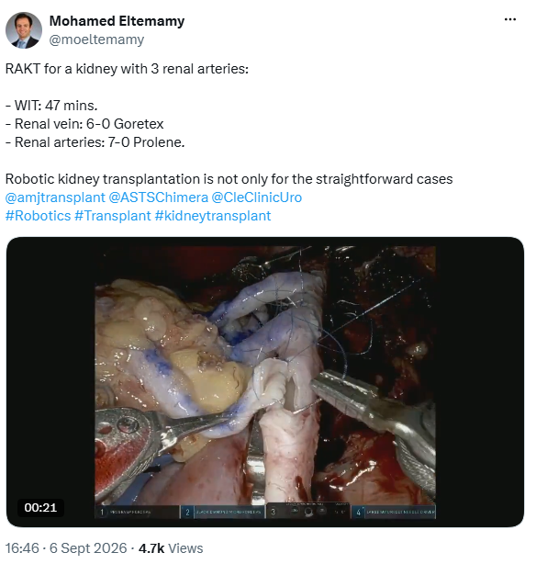
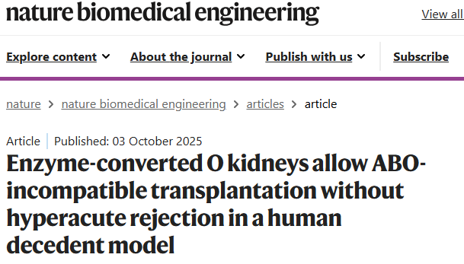
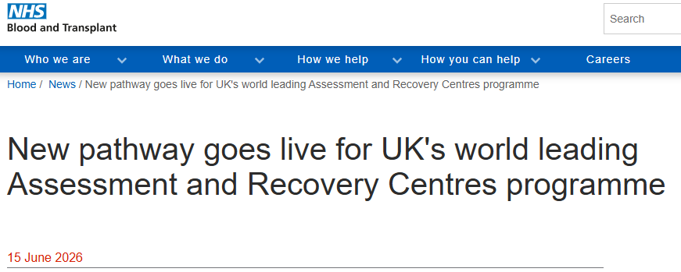
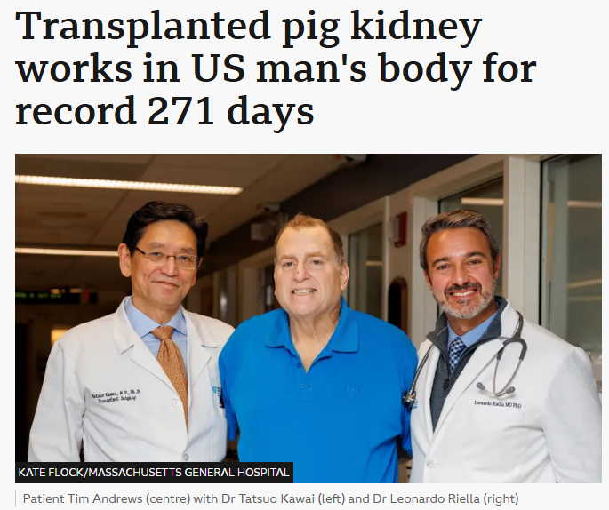
Belfast is keen to start a RAKT programme!
Belfast is keen to be part of ARCs fast track pilot!

